Slide 1
Supplier Quality Review Training Material
Nordin Mimouni – Supplier Quality Manager
Rev. 1 – June 26th 2017

Slide 2
Training
Outline
SQR Definition/Purpose
and Objectives – Link to QBR
SQR Participants
Understanding the SQR Process – Zero Defect Program
Supplier Expectations

Slide 3
SQR Definition/Purpose and Objectives – Link to QBR
SQR stands for Supplier Quality Review
Purpose is to review Supplier quality performance
The main objective is to have a continuous improvement trajectory
from our Suppliers
SQR is integrated to our Quarter Business Review (QBR)
and addresses the quality portion of it
SQR is part of our toolbox to achieve 0 defect by focusing
on preventing recurrence
The owner of this activity is the Global Supplier Quality Manager
Note: The word “shall” indicates mandatory requirements. The word “should” indicates a recommendation

Slide 4
SQR Definition/Purpose and Objectives – Link to QBR
SQR is
  A collaborative event between Camso and its key Suppliers
  A collaborative method to align on quality priorities
  A way of strenghtening Teamwork
  A tool to build trust between our Teams
SQR is not
  An audit
  A new tool, « rocket science »
  An activity performed in the office or in conference call
  A tool to blame our Suppliers
  A one time event

Slide 5
SQR Participants
Participants
Camso – Category Sourcing
Camso – Supplier Quality Manager
Camso – Procurement Project Leader
Camso – SQD or SPQD Function
Camso – Facility QA
Supplier - Representative(s) (covering functions: Quality, Account Management, Sales, Technical)
Support (if necessary)
Camso – Product Engineer
Camso – Project Manager
Camso – Logistics
Camso – Industrial Engineer
Camso – Raw Material Expert
Supplier – Logistics

Slide 6
Understanding the SQR Process
PREPARE
Camso and Supplier analyse last 12 months quality data: internal ppm, external ppm, top 3 failure modes,
supplier roadmap, Camso quality policy, business case…
Supplier prepares one (1) A3 per failure mode to analyse technical occurrence causes, technical non detection causes and focus on systemic causes (why not predicted, why not prevented and why customer not protected)
AGREE
Agree on roadmap with Camso representatives: Strategic buyer + Supplier Quality Manager
FOLLOW-UP
Report progress on roadmap: A3 status review, KPI/KPC, 0 defect status
CELEBRATE
Measure ‘0 defect Quarters’
Submit official 0 defect commitment
Prepare Gemba Reviews / PFMEA Go&See&Fix events
Celebrate ‘0 defect Quarters’
4 STEPS
&
CONTINUOUS
IMPROVEMENTS

Slide 7
Supplier Expectations
Transparency: we ask you to share data!
Preparation: we ask you to prepare SQR in advance
Participation: SQR is a living process
Autonomy:
  We ask YOUR roadmap, we will not impose it!
  We ask you to report progress on quarterly basis
Zero Defect attitude:
  We don’t impose a ppm target, we ask for 0 defect
  All activities shall target 0 recurrence

Slide 8
Back up slides

Slide 9

Zero Defect Definition
AT SUPPLIER LEVEL, A « ZERO DEFECT » LINE OR UNIT SHALL REACH DURING MIN 1 MONTH
0 PPM CUSTOMER
0 CLAIMS (SQI)
0 REJECT
AT GP12 STATION
0 NON CONFORMANCE FROM THEIR SUPPLIERS
0 DOUBLE TEST
0 INTERNAL REJECTS
0 PART ON THE FLOOR
0 NON CONFORM COP
ZERO EVENT ON TOP DEFECTS
AT CUSTOMER
CURRENT DEFINITION

Slide 10
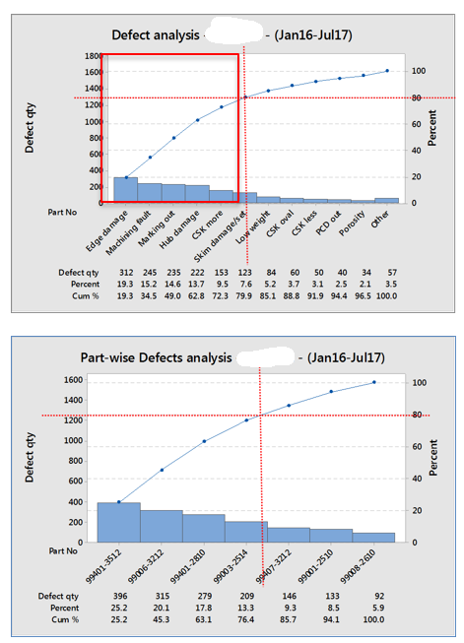
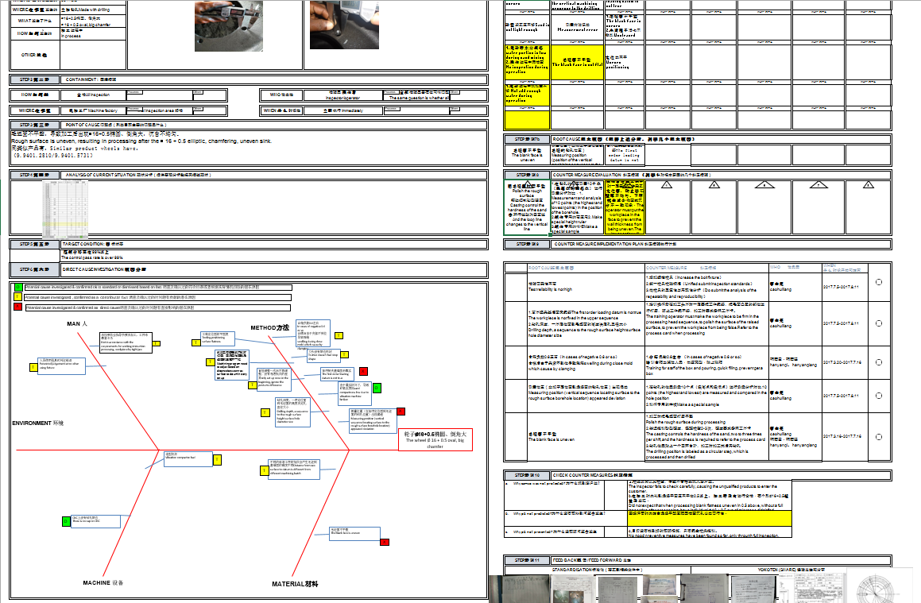
SQR Process – Prepare data and Agree
Example: Camso ppm related to Supplier defects
One (1) A3 per Top defect
Agreement on containment activities
Agreement on potential root causes
(occurrence and non detection)
Agreement on systemic causes: why not predicted,
prevented and Camso not protected
Agreement on action plan (short/mid/long term)
Start Zero Defect Counter

Slide 11
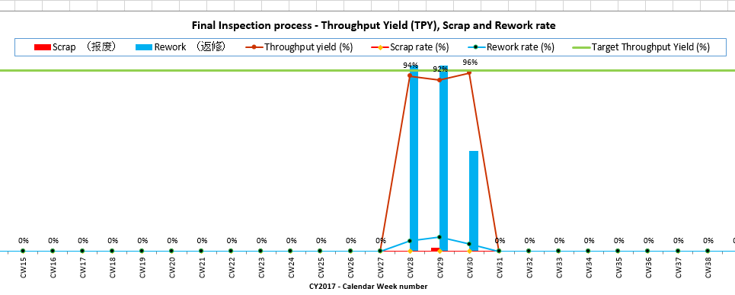
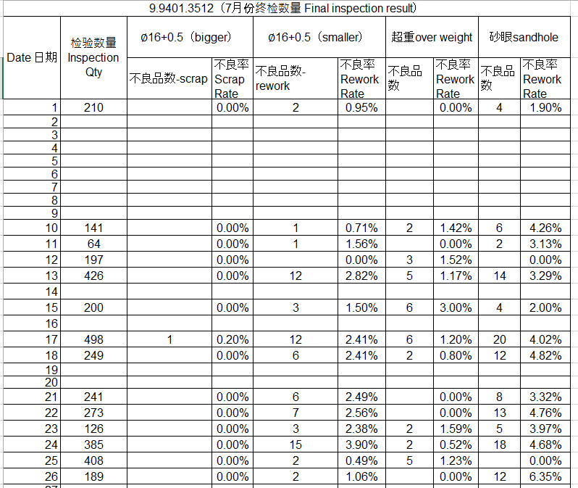
SQR Process – Follow up tools
Example: KPI on TPY

