Slide 1
Welding process introduction
Songsong Shi – Supplier Quality Specialist
Rev. 01 – Jan 14th 2019

Slide 2
Purpose of the training
Basic welding knowledge
Camso Requirements on welding process validation
Camso Requirements on welded product validation
Welding verification in Camso project development
Supplier Expectations
Training Outline

Slide 3
Purpose of the training

Slide 4
Purpose of the training
To understand CAMSO’s Welding spec and key requirements
To understand how to validate welding process
To understand how to validate the welded parts and welding verification during project development phase (DPAR,P3,PPAP, LBP, mass production)
To understand Camso’s expectation on suppliers
Notes:
You can open the file in parallel

Slide 5
Basic welding knowledge

Slide 6
Abbreviation
Abbreviation | Full Name | Chinese Name
AW | Arc Welding | 电弧焊
FCAW | Flux cored arc welding | 药芯焊丝电弧焊
GMAW =(MIGW/MAGW) | Gas Metal Arc Welding | 熔化极气体保护电弧焊
MIGW | Metal inert gas welding | 熔化极惰性气体保护焊
MAGW | Metal Active Gas Welding | 熔化极活性气体保护焊
GTAW=TIGW | Gas Tungsten Arc Welding | 氩弧焊(钨极惰性气体保护焊
TIGW | Tungsten Inert Gas Welding | 钨极惰性气体保护焊
SMAW | Shielded Metal Arc Welding | 气体保护金属极电弧焊
SAW | Submerged Arc Welding | 埋弧焊
FW | Flash Welding | 闪光焊
PAW | Plasma Arc Welding | 等离子焊
Notes:
You can open the file in parallel

Slide 7
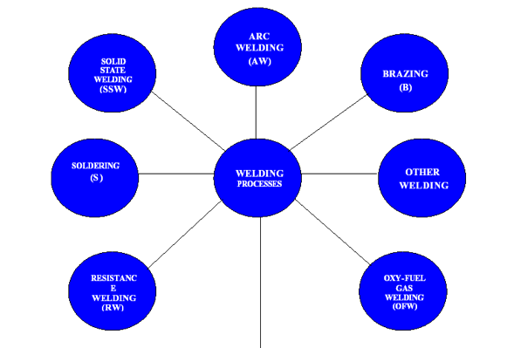
Welding Processes

Slide 8
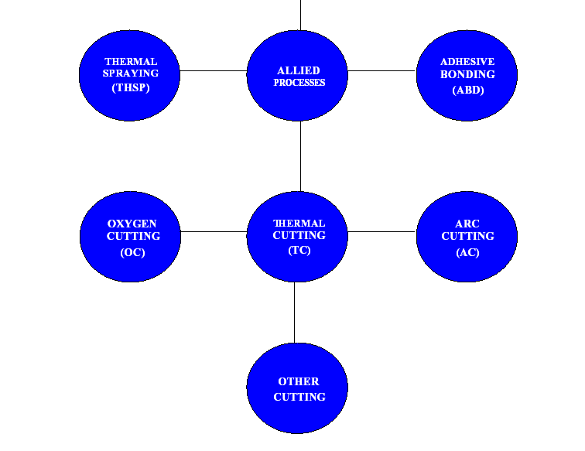
Welding Processes

Slide 9
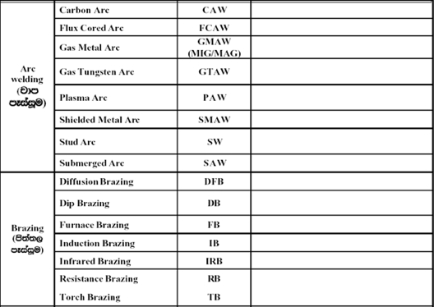

Slide 10
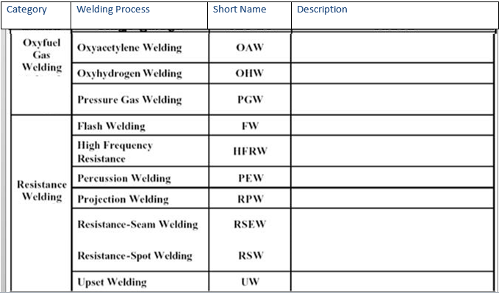

Slide 11
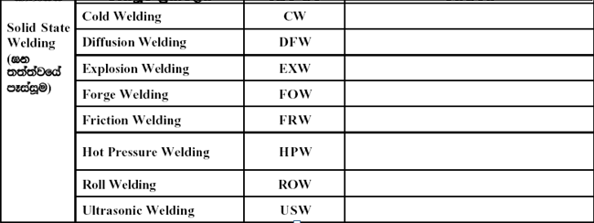

Slide 12
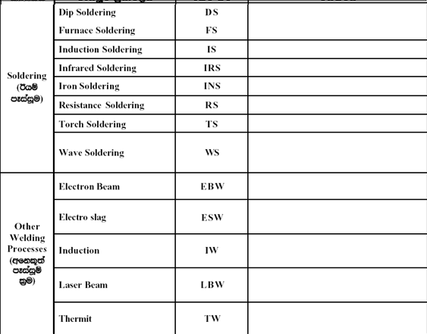

Slide 13
Arc Welding
MIGW：（Ar保护 & Helium & mixed gases）Metal Inert Gas Welding
Pulse MIG脉冲
GMAW熔化极气保焊
Solid Wire实心焊丝气保焊
Non Pulse MIG
Pulse MAG
MAGW：Active gas (CO₂)
Non Pulse MAG
FCAW: CO2气保焊
Ar+CO2 mixed gases
FCAW药芯焊丝气保焊
Flux cored wire
GTAW(TIGW)钨极惰性气体保护焊
Solid wire实心焊丝
Argon gas
SAW
-Solid wire
-Flux cored wire
Flux

Slide 14
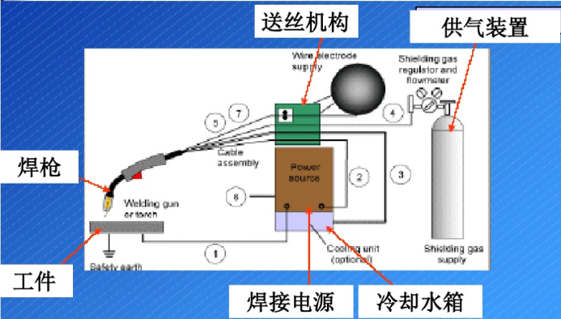
Arc welding- common type applied for Camso product

Slide 15
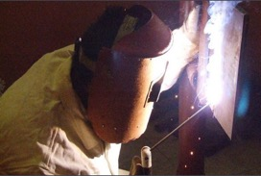
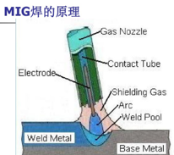
Arc welding- including SMAW, GMAW,MIG,MAG
SMAW: Shielded Metal Arc Welding
GMAW: Gas Metal Arc Welding
MIGW (Metal Inert Gas Welding): Ar or He
MAGW (Metal Active Gas Welding): Ar or He+ O2or CO2

Slide 16
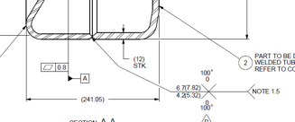
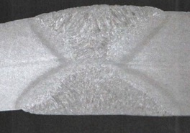
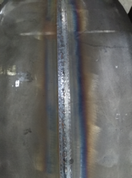
Example of CAMSO’s product welding type
GMAW: Gas Metal Arc Welding
Gas Metal Arc Welding: Ar(80%) + CO2(20%) (This is almost nearly MAGW)
Double V welding- Stamped wheel
Notes:
You can open the file in parallel

Slide 17
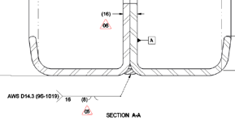
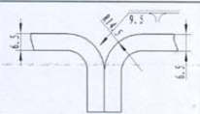
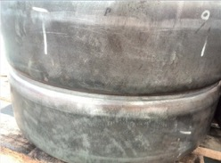
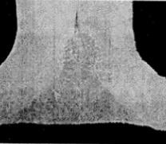
Example of CAMSO’s product welding type
Single V welding- Stamped wheel
Notes:
You can open the file in parallel

Slide 18
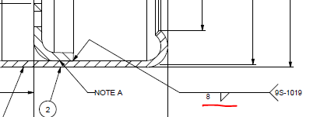
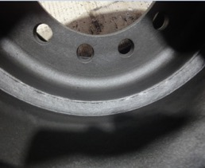
Example of CAMSO’s product welding type
Lap joint fillet welding- Stamped wheel
Notes:
You can open the file in parallel

Slide 19
Camso Requirements on welding process validation

Slide 20
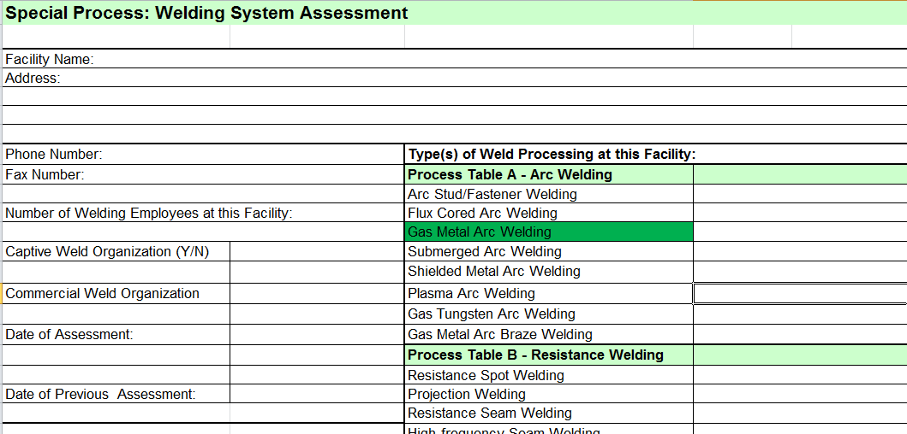
Potential supplier evaluation:
QMS audit+ special process audit: If we select new supplier to do the welding, we need to make the QMS audit and special process audit based on CQI-15.
CQI-15: Welding System Assessment: to confirm the type of weld processing at this facility;
Notes:
You can open the file in parallel

Slide 21
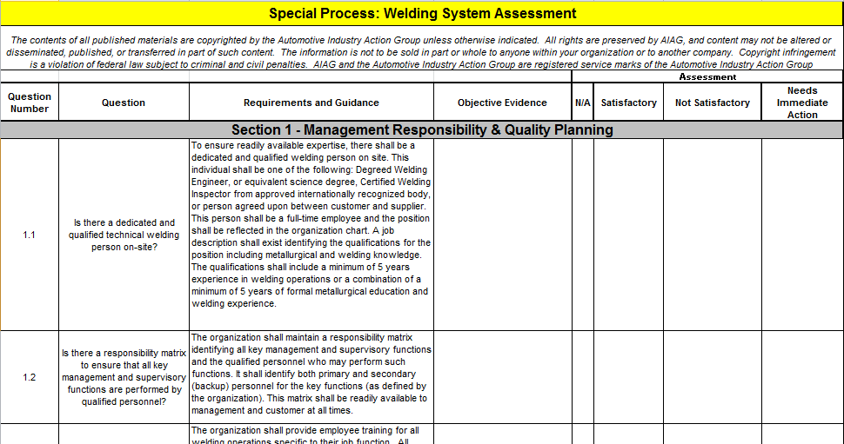
Potential supplier evaluation:
Element section1~5:
Section 1 Management Responsibility & Quality Planning;
Section 2 - Floor and Material Handling Responsibility;
Section 3 - Equipment / Facilities/Controls;
Section 4 - TOOLING/FIXTURING;
Section 5 - PROCESS CONTROLS AND CONFIRMATION;
Notes:
You can open the file in parallel

Slide 22
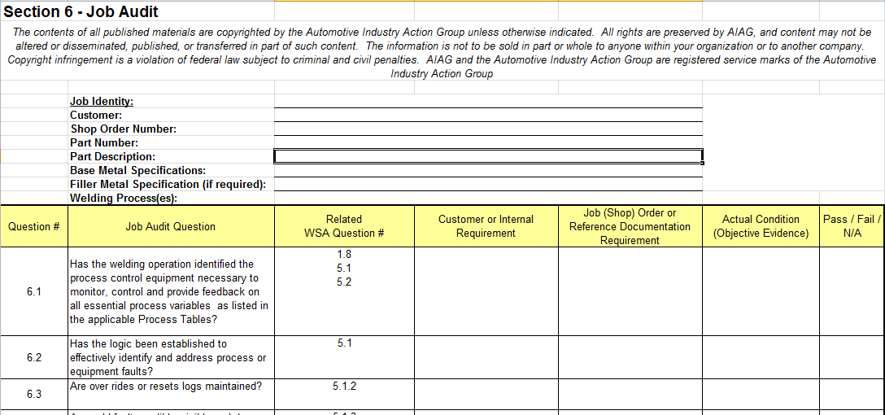
Potential supplier evaluation:
Section 6 - Job Audit:
Notes:
You can open the file in parallel

Slide 23
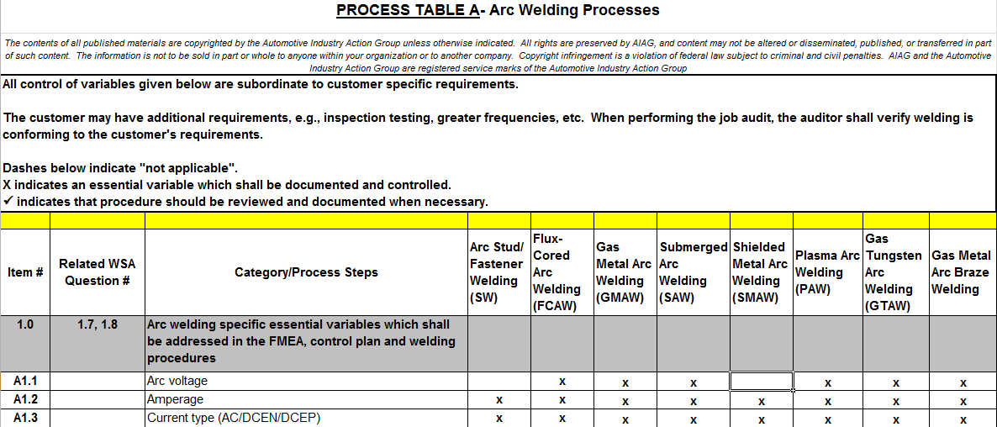
Potential supplier evaluation:
Process Table A: Arc Welding Process
Notes:
You can open the file in parallel

Slide 24
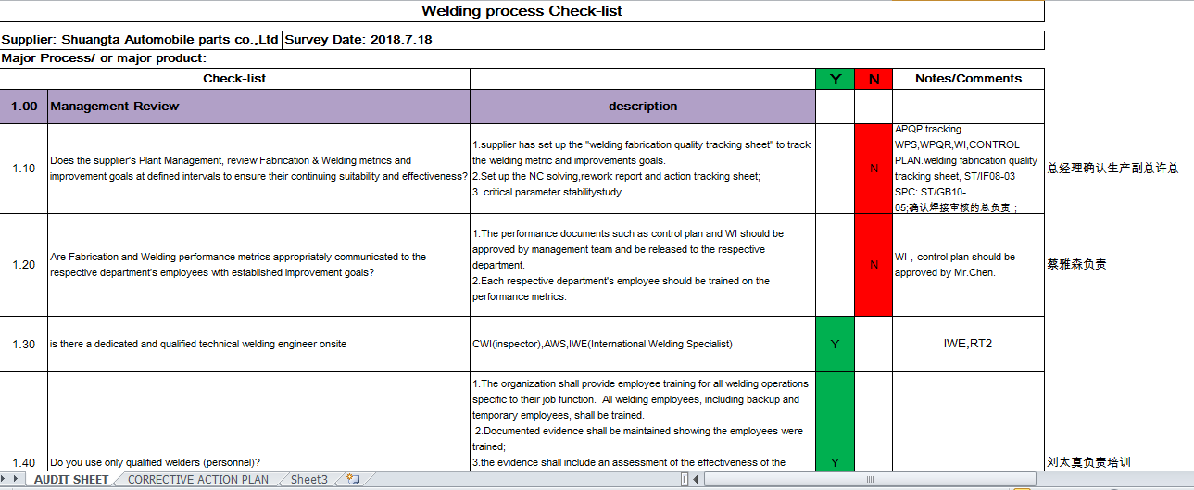
PPAP process validation
In PPAP and mass production, we will use welding checking list. Totally 10 items: Management Review, Quality Planning, Document Control, Product Identification and Traceability, Process Control, Equipment / Facilities/Tooling /Fixture, Inspection, Measuring and Testing, Control of Non-conforming Product, Corrective and Preventive Action, Training.
Notes:
You can open the file in parallel

Slide 25
Camso Requirements on welded product validation

Slide 26
Product validation requirement
Dimension: welding size(weld leg length, Z; weld throat thickness, a)
Section check: welding size, macro etching, penetration, crack, tensile, bend test
welding quality- internal: porosity, slag inclusion, lack of fusion
welding quality- appearance: porosity, welding slag, underfill, crack,
undercut, overlap, crater

Slide 27
Standards on welded product validation
Camso Spec for welding :
9S-1019：This specification covers the engineering requirements of welds, welding materials, and welders. It also defines welding imperfections and sets minimum weld quality requirements for joining metals using arc welding processes.
9S-1018：This material is used in the manufacturing of welding of an ATV/UTV products. specifies the quality criteria for welded joints and explains what is not acceptable and what is anticipated as quality on a welded product.
International spec:
AWS D1.1 / D1.1M : 2008: Structural Welding Code – Steel
AWS D14.3/D14.3M:Specification for Welding Earthmoving, Construction and Agricultural Equipment.
Construction & Material Handling BUs: ISO 3834-2 (under that ISO 15614-1, 15614-13 etc)
Notes:
You can open the file in parallel

Slide 28
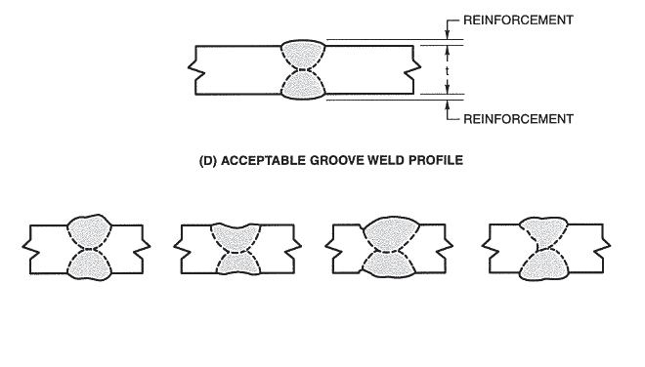
Dimension- welding size
Groove welds in butt joints: The height of weld reinforcement shall not exceed 3mm for a joint or weld sizes up to and including 50mm. The weld reinforcement of weld size over 50mm shall not exceed 5mm, as shown in figure below.
In case of wheels with groove welds exposed to rubberizing (default), a maximum of 1mm reinforcement is allowed. Groove welds on wheels not exposed to rubber will be indicated as
Notes:
You can open the file in parallel

Slide 29
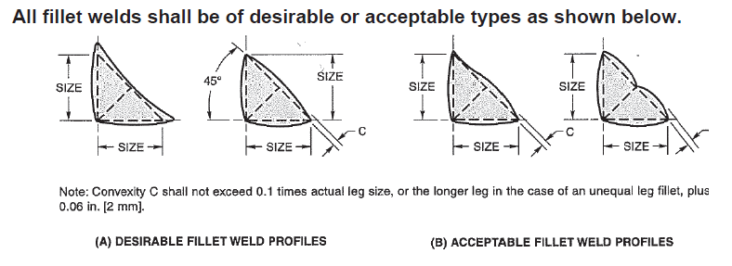
Dimension- welding size
Construction & Material Handling BUs cover this under, ISO 6520-1 & ISO 6520-2
Quality level – As per ISO 5817-B
Acceptance criteria – As per ISO 5817-B
FILLET WELDS::
Notes:
You can open the file in parallel

Slide 30
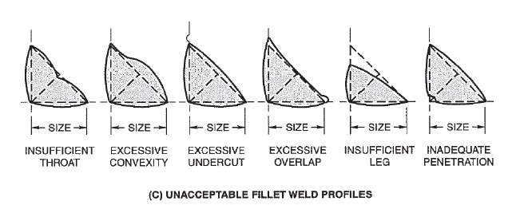
Dimension- welding size
Fillet weld leg size shall conform to the following tolerances based on a measurement of fused leg length:
Weld size under 10mm: +3mm, -1mm.
Weld size 10mm and over: +3mm, -1.6mm.:
Notes:
You can open the file in parallel

Slide 31
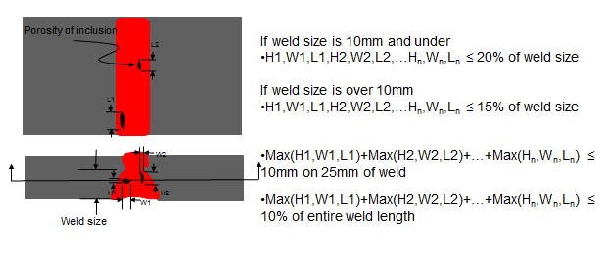
Welding quality- internal
Three dimensional-type discontinuities. Permissible in discontinuous distribution, provided the largest dimension of any single discontinuity does not exceed the following:
-20% of the weld size or joint penetration for weld size of 10mm and under.
-15% of the weld size or joint penetration for weld size over 10mm.
The sum total of the porosities greater dimension shall not exceed 10mm in any 25mm of linear length of weld, nor 10% of the weld length.
Notes:
You can open the file in parallel

Slide 32
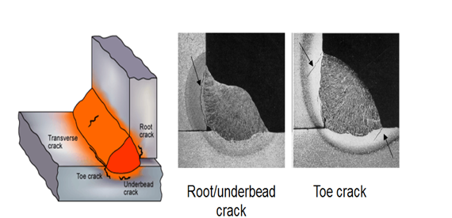
Welding quality- internal
Underbead Cracks: Not permissible.
Notes:
You can open the file in parallel

Slide 33
Welding quality- internal
Planar-type discontinuities (lack of fusion, slag inclusions, or fissures)
Permissible to 25% of specified weld size, or less than 25% of the joint penetration in height or width. The length of an individual discontinuity, or the sum of discontinuities, shall not exceed 10% of the weld length for up to 180mm of weld.
Notes:
You can open the file in parallel

Slide 34
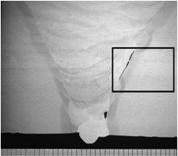
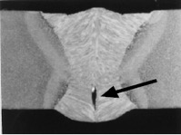
Welding quality- internal
Lack of fusion
Slag inclusion
Crack/fissue in weld bead
Notes:
You can open the file in parallel

Slide 35
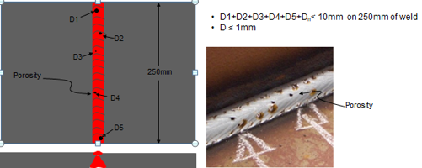
Welding quality- Appearance
Porosity: The sum of diameters of visual or surface porosity, including piping porosity, shall not exceed 10mm in any 250 mm length of weld, with no single void exceeding 1.0mm in diameter, regardless of the fillet size.
Notes:
You can open the file in parallel

Slide 36
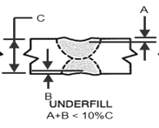
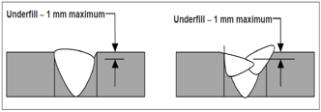
Welding quality- Appearance
underfill:
Groove welds underfill in butt joint: For material thickness above 9mm: Shall not exceed 1mm. For material thickness of 9mm or less;
Double groove weld: Weld section shall not have combined weld underfill exceeding 10% of total section thickness. Shall not exceed 10% of material thickness.
In all cases, the length of the underfill allowed shall not exceed 50% of the total weld length.
Notes:
You can open the file in parallel

Slide 37
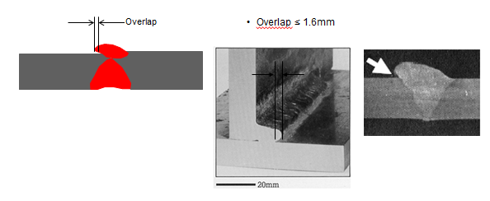
Welding quality- Appearance
5.3.1. Weld overlap: Shall not exceed 1.6mm beyond the fusion line of the weld.
Notes:
You can open the file in parallel

Slide 38
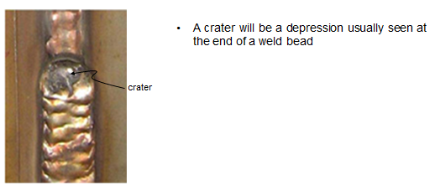
Welding quality- Appearance
5.3.2. Craters: Not permissible. Shall be filled to at least 85% of the full cross section of the welds..
Notes:
You can open the file in parallel

Slide 39
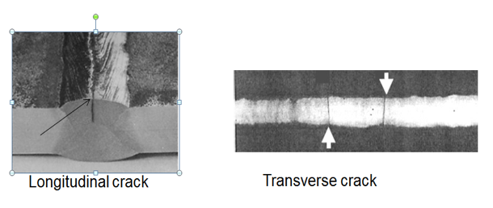
Welding quality- Appearance
5.3.3. Cracks: No cracks in the welds or in adjacent base metal surfaces are allowed.
Notes:
You can open the file in parallel

Slide 40
Welding quality- Appearance
Undercut:
For material thickness to and including 6mm: Shall not exceed 10% of material thickness.
For material thickness greater than 6mm: shall not exceed 1mm. In addition, 1.6mm undercut depth up to 25mm continuous length in any 300mm weld length is permissible; the accumulative length is not to exceed 38mm in the same 300mm length.
Notes:
You can open the file in parallel

Slide 41
Welding verification in Camso project development

Slide 42
Output in different Project development phase
DPAR
Measurement Agreement
Welding requirement list
P3
WPS
WPQR
RT(100%),UT(1pcs)
PPAP
RT(30%)
UT(1PCS)Reference
Welding check list/audit by SPQDE
LBP
RT(10%)
UT(1pcs)Reference
Welding check list/Audit by supplier
Mass P
RT(1PCS/EACH BATCH)
Welding Check list/audit by supplier
Notes:
You can open the file in parallel

Slide 43
DPAR:
Measurement agreement:
Notes:
You can open the file in parallel

Slide 44
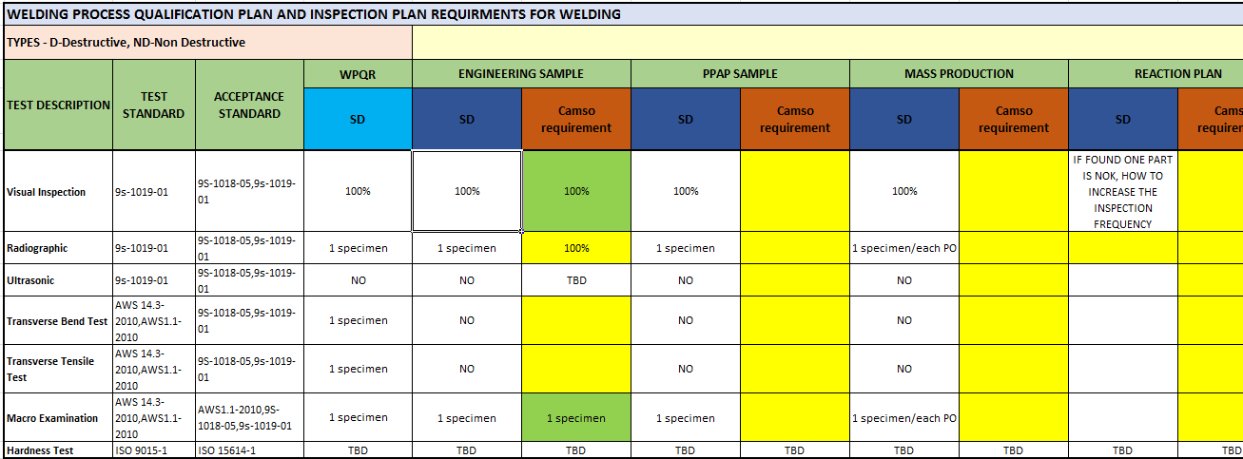
DPAR:
Welding requirement list
Notes:
You can open the file in parallel

Slide 45
P3
WPS and WPQR
PWPS
Preliminary Welding Procedure Specification: set up the welding parameter.
WPQR
WPS
Welding Procedure Quality Record: make the penetration, tensile,bending test and record it.
Welding Procedure Specification: finalize the parameter again based on WPQR
Notes:
You can open the file in parallel

Slide 46
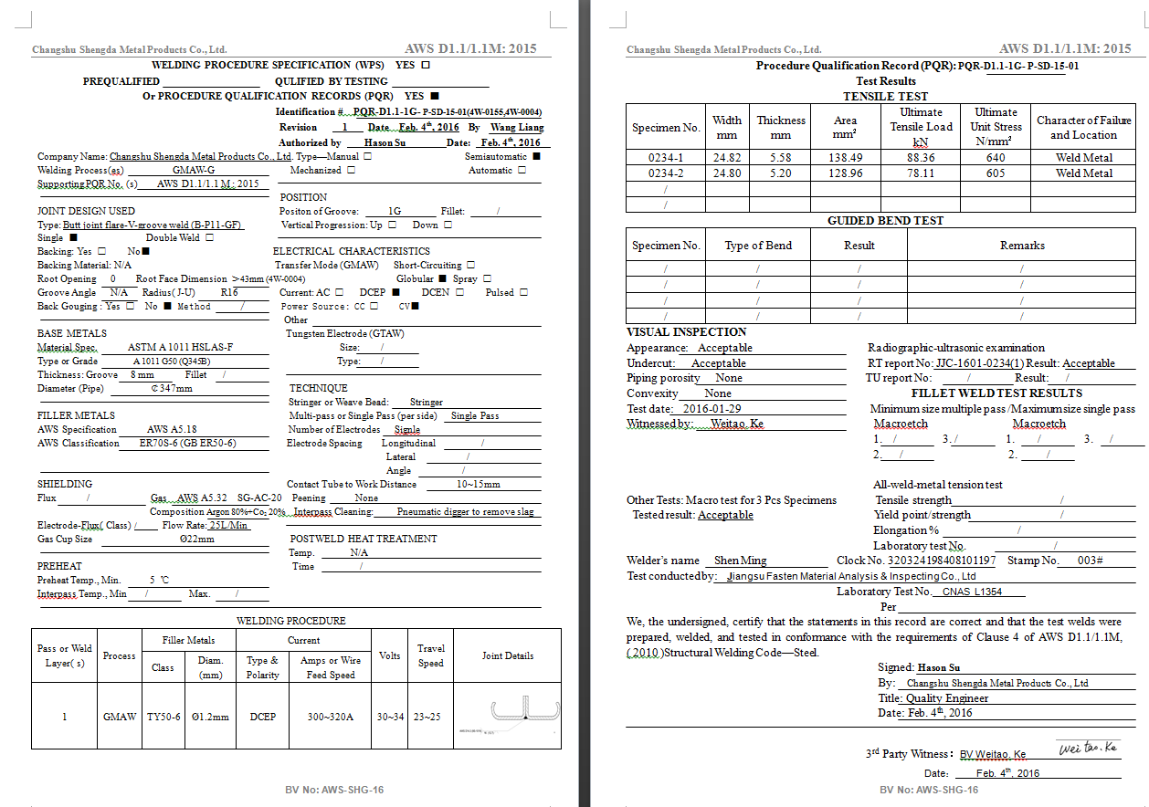
Example for WPS and WPQR:
Notes:
You can open the file in parallel

Slide 47
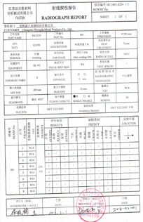
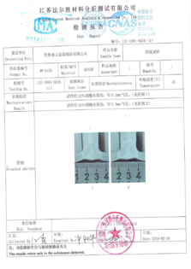
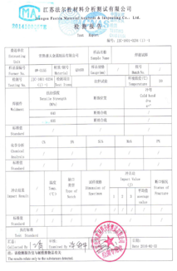
Example for RT report
Micro Tech report – weld size test report, Penetration
Micro Tech report – tension test report size
Notes:
You can open the file in parallel

Slide 48
Supplier Expectations

Slide 49
Supplier Expectations
Review each “note” and “dimensions” from drawing for concerns
Prepare Measurement Agreement before DPAR
Set up welding requirement list before DPAR
Make PWPS after DPAR
Define which WPQR need to be done by 3rd party.
Ensure welder and welding engineer be certified
Define inspection method, facility and frequency
Make the WPQR after P3 samples completed
Finalize WPS after WPQR be approved by CAMSO
Assist CAMSO to do self audit based on Welding check list

