Slide 1
Global Procurement - Supplier Quality Understanding SPC
Lise Robert SQS (Supplier Quality Specialist)
Rev. 01 – Nov 29th 2018

Slide 2
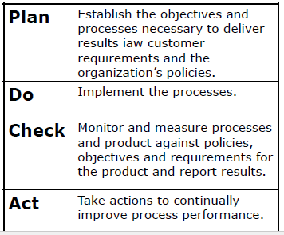
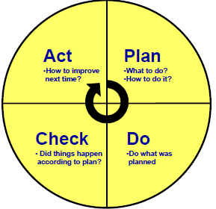
PDCA – SPC Process

Slide 4
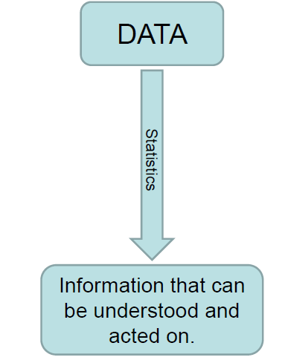
SPC- Data for Process

Slide 5
Brief on SPC

Slide 6
Brief on SPC

Slide 7
Brief on SPC

Slide 8
SPC & Relationship with Quality Tools

Slide 9
SPC - Datas

Slide 11
SPC - Definitions

Slide 13
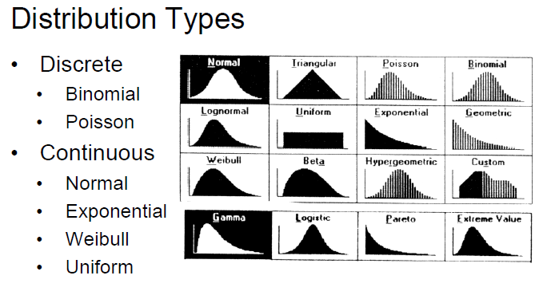
SPC - Definitions

Slide 14
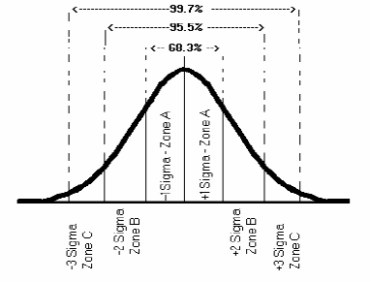
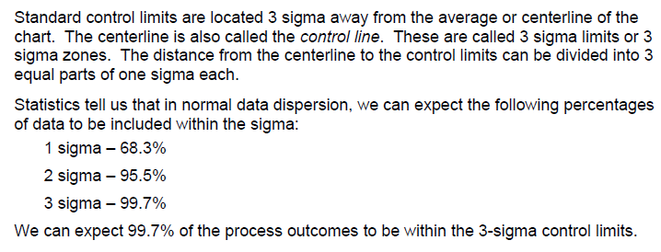
SPC- Zone of Control Charts
Many of the standard rules examine points base on Zones.
Area within control limits is divided into 3 zones, Zone A-3 sigma zone, Zone B- 2-Sigma Zone and Zone C- 1-sigma zone.
Centerline = Control line

Slide 15
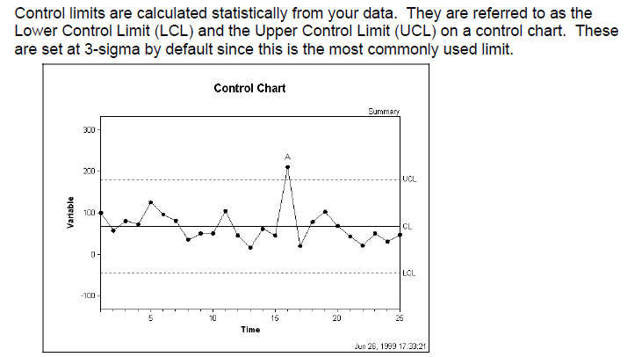
SPC- Control Limits

Slide 16
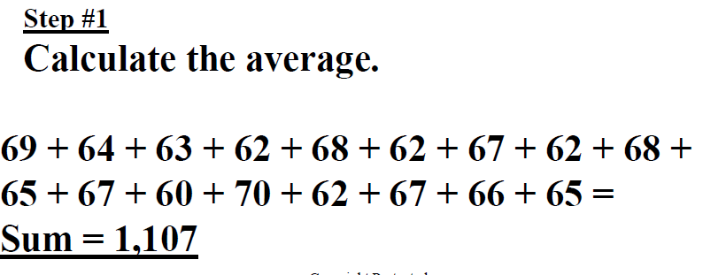
SHORT RUN SPC
Example, how to calculate the upper and lower control limits

Slide 17
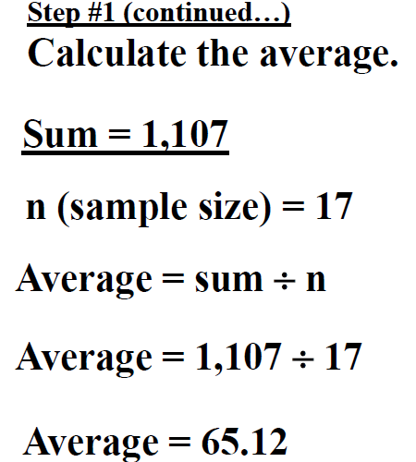
SHORT RUN SPC

Slide 18
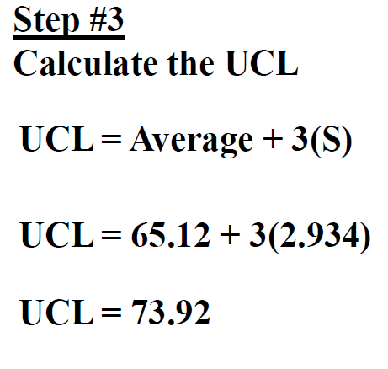
SHORT RUN SPC

Slide 19
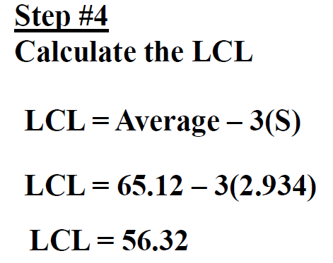
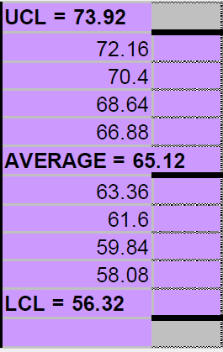
SHORT RUN SPC

Slide 20
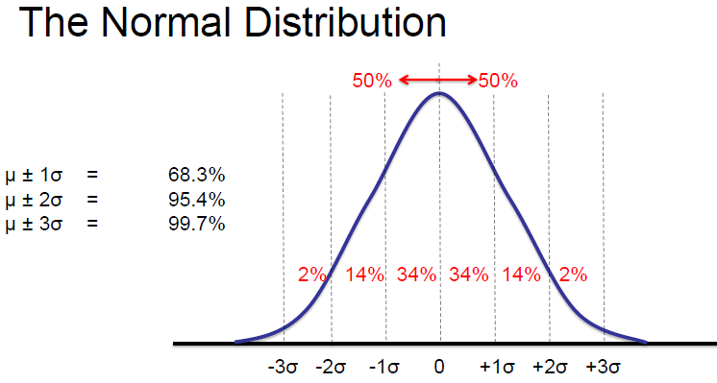
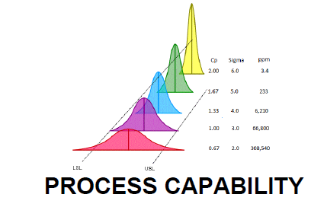
SPC Limits and Spreads

Slide 21
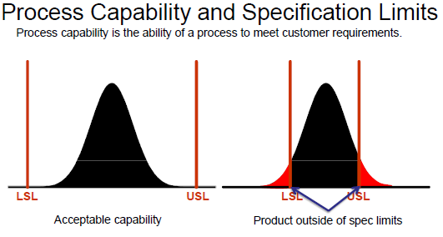
Process Capability in SPC

Slide 22
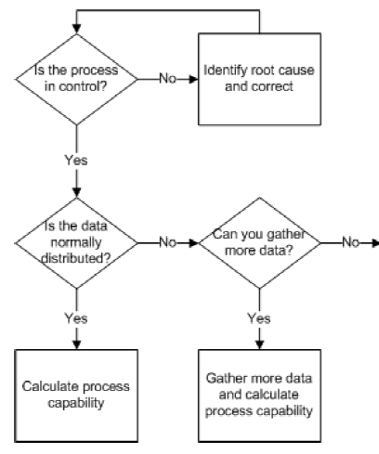
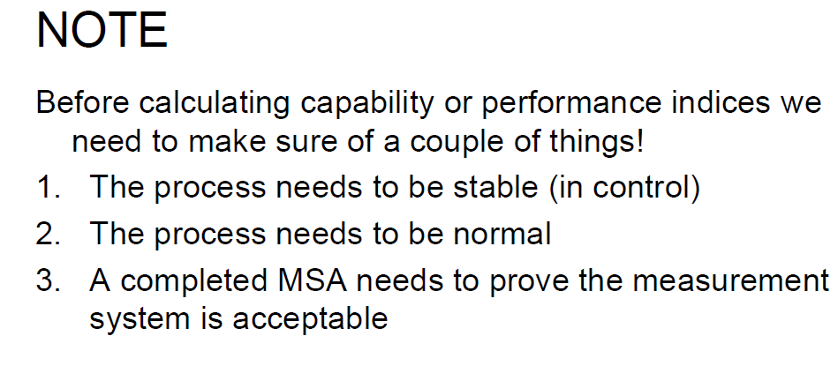
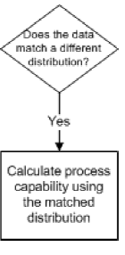
Calculating Process Capability Flow

Slide 23
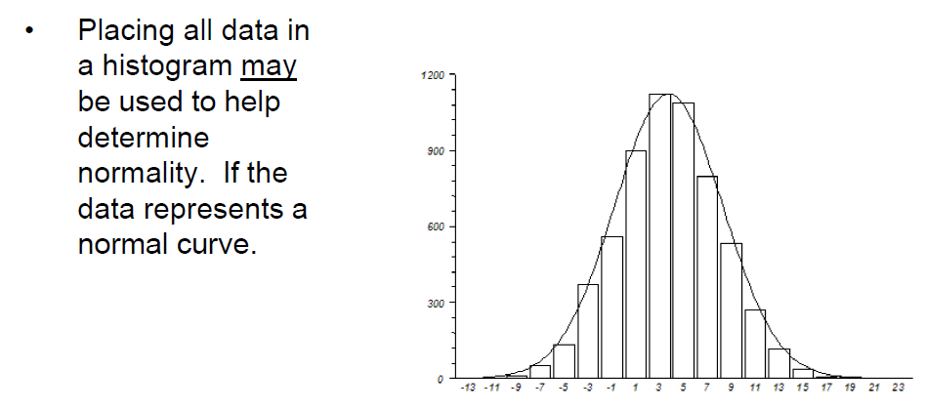
Data Collection: Determine Normality

Slide 24
Determine Normality

Slide 25
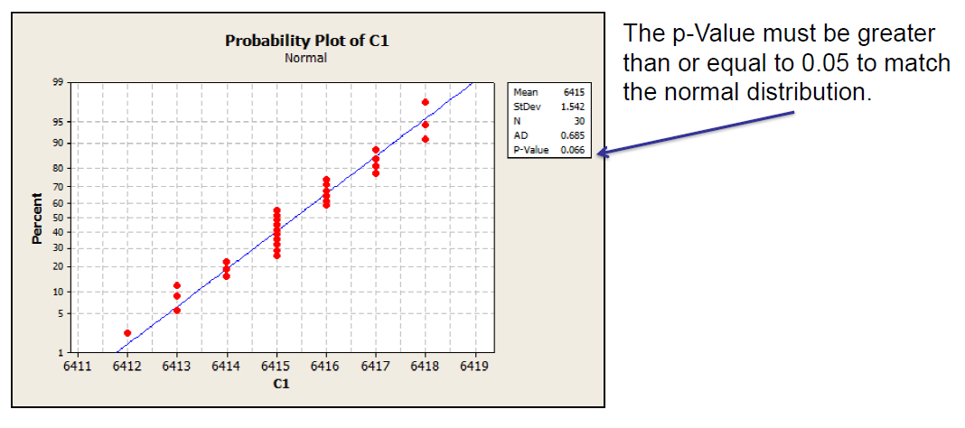
Interpreting Normality

Slide 26
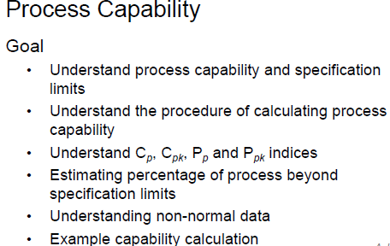
Process Capability in SPC

Slide 27
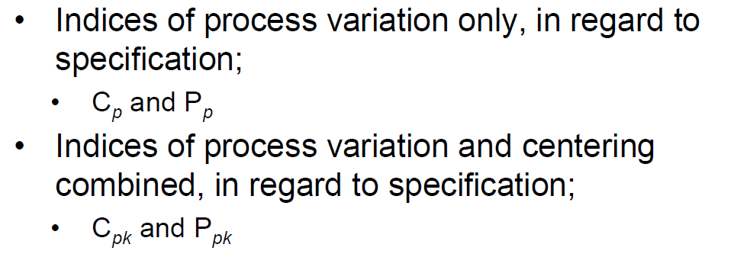
Process Indices

Slide 28
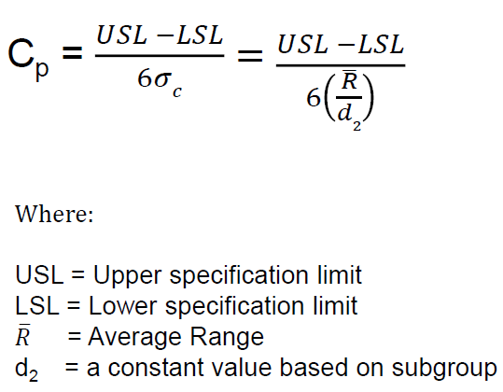
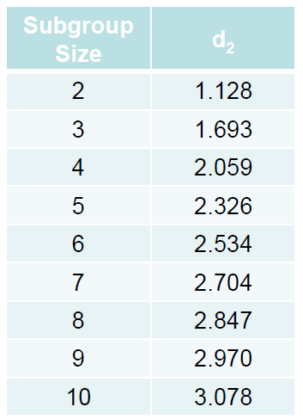
Cp Calculation Overview

Slide 29
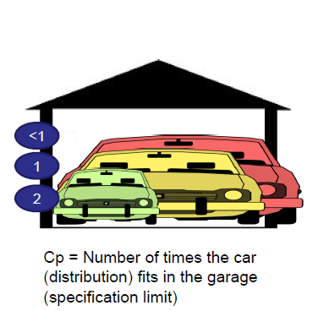
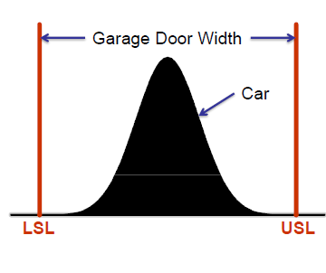
Simple - Interpreting Cp

Slide 30
C pk Calculation

Slide 31
Simple - Interpreting Cpk

Slide 32
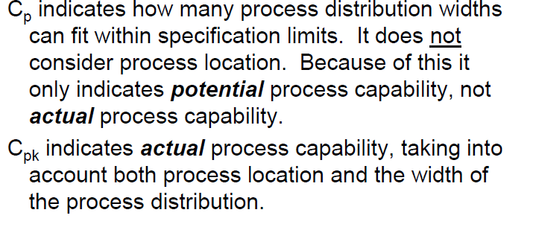
Brief – Cp / Cpk Review

Slide 33
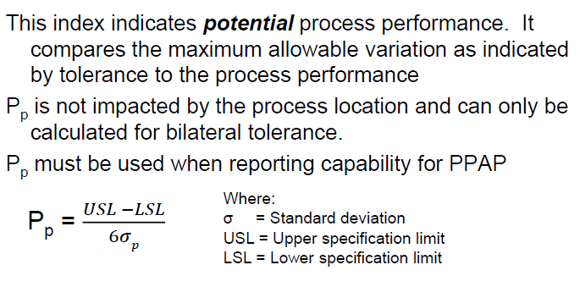
P p Overview

Slide 34
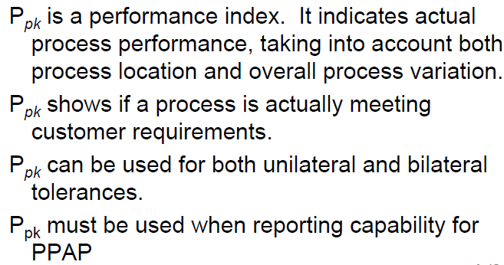
P pk Overview

Slide 35
Brief – P pk Calcuation

Slide 36
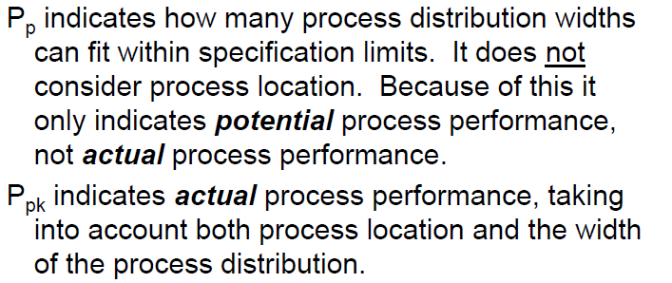
Breif – Pp / P pk Review

Slide 37
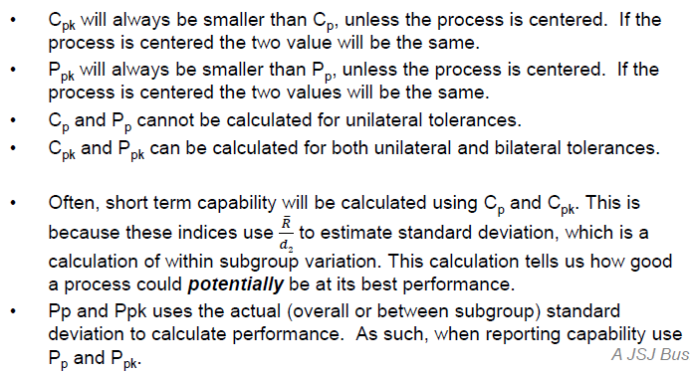
Important Tips – Process Capabilities

Slide 38
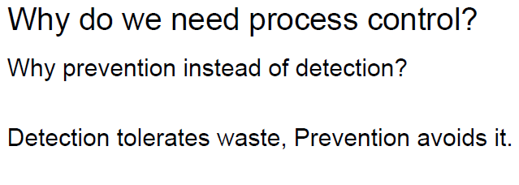
SPC - PDCA

Slide 39
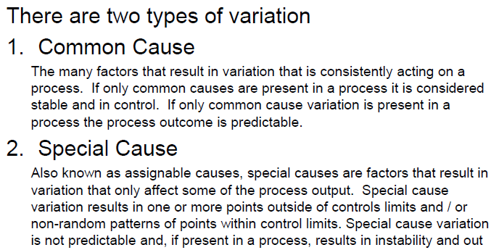
Process Variations is main factors

Slide 40
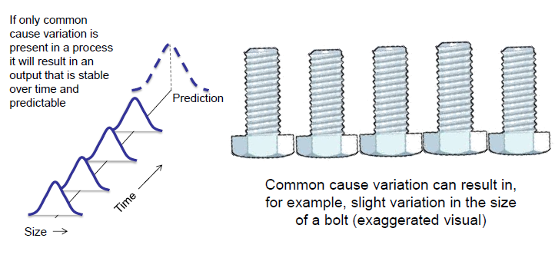
Example of Common Causes

Slide 41
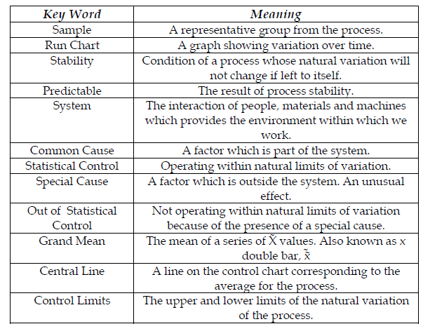
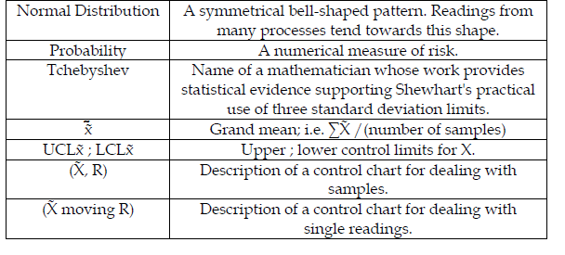
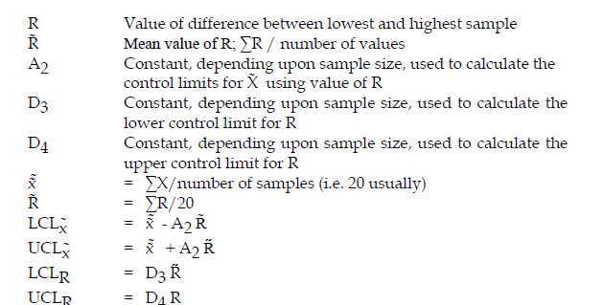
Meaning of Key Words and Symbols in SPC

