Slide 1
Quarterly Business Review Training Material Christophe Santoro – Category Sourcing Manager Rev. 1 – June 11th 2017

Slide 2
Training Outline – 30min
Introduction
QBR inside our streams
Purpose/Goal
SIPOC/Process Mapping
QBR Procedure / Template / Training
Conclusion
Questions/Answers

Slide 3
Introduction
QBR stands for Quarterly Business Review
Good practise (one of the 5 key processes)

Slide 4
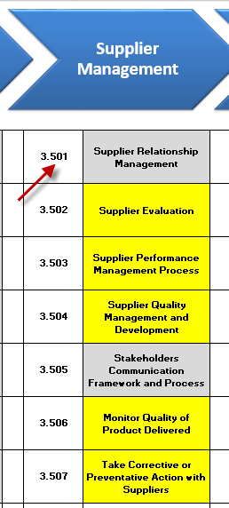
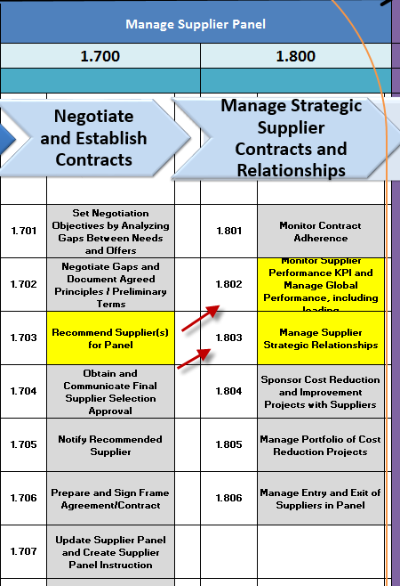
QBR inside our streams

Slide 5
Purpose/Goal
The purpose of this process is to monitor supplier strategic relationships
Provide a global overview to each Camso stakeholder: current business situation and challenges
Reinforce partnership and lean 2-way communication through a structured approach
Notes:
The purpose of this process is to monitor supplier strategic relationships.
This process shall be conducted on a quarterly basis for key suppliers.
The goal is to ensure that both parties have a clear understanding of current business situation in terms of: Quality, Delivery, Capacity, Customer Experience, General performance…

Slide 6
SIPOC/Process Mapping
Notes:
Possibility to add hyperlink to the process mapping

Slide 7
QBR Procedure / Template / Training
in GP Toolbox (Camso)
in Supplier Portal (Suppliers)

Slide 8
Conclusion
Let’s PDCA!
Plan your QBR
Just Do it!
Check it’s done and that we have valuable outputs
Act as a “Kaizen agent”: suggestion, CIP, LLs…

Slide 9
Questions/Answers

