Slide 1
Global Procurement - Supplier Quality
PFMEA training
Lise Robert SQS (Supplier Quality Specialist)
Rev. 01 – Nov 29th 2018

Slide 2
The purpose is to share the benefits of a detailed PFD (process Flow Diagram, conducted during a PFMEA (process failure mode effects analysis), that will ensure product quality
in the manufacturing/ assembly process.
What is the purpose of this presentation?

Slide 3
Overview Objective
Failure Mode Effect Analysis (FMEA) – Provide a Basic familiarization with a tool that aids in quantifying severity, occurrences and detection of failures, and guides the creation of corrective action, process improvement and risk mitigation plans.

Slide 4
FMEA
Why does it always seem that we have plenty of time to fix our problems, once they occur, but never enough time to prevent the problems by doing it right the first time?

Slide 5
1- FMEA History
2- What is FMEA
  Definitions
  What it Can Do For You
3- Types of FMEA
4- Team Members Roles
5- FMEA Terminology
6- Getting Started with an FMEA
7- The Worksheet
8- FMEA Scoring
Agenda

Slide 6
1- HISTORY

Slide 7
1- FMEA History
This “type” of thinking has been around for hundreds of years. It was used in 1940 by the military to ensure that weapons were functional, It was then formalized in the aerospace industry during the Apollo program in the 1960’s.
Initial automotive adoption in the 1970’s.
  To prevent Potential serious & frequent safety issues.
Required by QS-9000 & Advanced Product Quality Planning Process in 1994
  For all automotive suppliers.
Now adopted by many other industries.
  To prevent potential serious & frequent safety issues or warranty issues.

Slide 8
2- WHAT IS A FMEA?

Slide 9
FMEA - Definition & Purpose
What is a FMEA ?
What is a FMEA ?
Systematic method to prevent:
  Potential failure cause(s)
  Potential failure mode(s)
  Potential effects of failure(s)
Tool to help identify All potential failure modes in a process
Tool to determine what controls are in place to prevent failure modes from happening
Documents all actions taken to reduce the Risk Priority Number (RPN)
Used to implement continuous improvement principles on manufacturing process
Failure Modes & Effect Analysis (FMEA)
Process and Design FMEA (PFMEA/DFMEA)

Slide 10
What is a FMEA?
Failure modes and effects analysis (FMEA):
FMEA is a step-by-step approach for identifying all possible failures in a design, a manufacturing or assembly process, or a product or service. “Failure modes” means the ways, or modes, in which something might fail.

Slide 11
What is a PFMEA?
A Process Failure Modes and Effects Analysis provides a structured, qualitative, analytical framework which taps the multi-disciplined experience of the team to brainstorm answers to such questions as:
How can this process, function, facility, or tooling fail?
What effect will process, function, facility, or tooling failures have on the end product (or Customer)?
How can potential failures be eliminated or controlled?
Based on the success of Failure Modes and Effects Analysis (FMEA), the PFMEA concept was developed to incorporate a broader analysis team to accomplish a thorough analysis in a short time
A PFMEA can be used to assess any process. The most common use of the PFMEA involves manufacturing processes
PFMEAs may be performed on new processes or to improve current processes
To maximize its value, a PFMEA should be performed as early in the manufacturing development cycle as possible
Notes:
1.0 What is a PFMEA?
l A Process Failure Modes and Effects Analysis provides a structured,
qualitative, analytical framework which taps the multi-disciplined
experience of the team to brainstorm answers to such questions as:
l How can this process, function, facility, or tooling fail?
l What effect will process, function, facility, or tooling failures have on the
end product (or customer)?
l How can potential failures be eliminated or controlled?
l Based on the success of Failure Modes and Effects Analysis (FMEA),
the PFMEA concept was developed to incorporate a broader analysis
team to accomplish a thorough analysis in a short time
l A PFMEA can be used to assess any process. The most
common use of the PFMEA involves manufacturing processes
l PFMEAs may be performed on new processes or to improve
current processes
l To maximize its value, a PFMEA should be performed as early in
the manufacturing development cycle as possible

Slide 12
What is a PFMEA? (cont`d)
It`s focus is on potential process-related failures and their causes.
A PFMEA typically assumes that the design is sound.
The recommended actions are to eliminate the root causes of the potential failures.

Slide 13
The purpose of a PFMEA
What it can do for you!
Identifies Design or process related Failure Modes before they happen.
Determines the Effect and the Severity of these failure modes.
Identifies the Causes and probability of Occurrence of the Failure Modes.
Identifies the Controls and their Effectiveness.
Quantifies and prioritizes the Risks associated with the Failure Modes.
Develops & documents Action Plans that will occur to reduce risk.

Slide 14
How does a FMEA eliminate risks of failures???
A FMEA is an analytical tool that uses a disciplined technique to identify and help eliminate product and process potential failure modes.
By the identification of potential failures
Assessing the risks caused by failure modes and Identifying the need of corrective actions
Prioritizing corrective actions
Carry out corrective actions

Slide 15
FMEA - Definition & Purpose
When should a PFMEA be done?
The FMEA is a living document that should always reflect:
  The latest design drawing level
  The latest relevant actions
This means that a review should at least be conducted when:
  A design change effects fit, form or function
  Previous recommended actions have been completed
  New knowledge is gained from related testing or failure occurrence
  and analysis

Slide 16
3- TYPE OF FMEA?

Slide 17
There are (since 2010) five main types of FMEA
The functional or system FMEA, allows, from the functional analysis, to determine the modes of failures or causes leading to a dreaded event;
The FMEA product, makes it possible to check the viability of a developed product with respect to the requirements of the customer or the application;
The FMEA process, identifies the potential risks associated with a manufacturing process leading to non-compliant products or loss of pace;
The FMEA of production, makes it possible to anticipate the risks related to the non-functioning or to the abnormal functioning of an equipment, a machine;
The FMEA of Flow, makes it possible to anticipate the risks related to material or information flow interruptions, the reaction or correction delays and the costs inherent in returning to normal.

Slide 18
The 2 main types of FMEA
Design “DFMEA”- (Driven by part or component functions)
The FMEA product (" Design FMEA ") improves and enhances
the product by identifying design weaknesses and their impact
on the customer
Process “PFMEA”- (Driven by process functions & part characteristics) A Process is a sequence of tasks that is organized to produce a product or provide a service. A Process FMEA is used to improve and make the process reliable, by identifying the effects of its failures on productivity and the product. It is particularly useful in maintenance and zero fault programs. ¨Doing it right the first time¨.

Slide 19
4- Team Members roles and how to conduct a PFMEA

Slide 20
Who creates a PFMEA?
PFMEA are created by a multi-disciplinary team consisting, at a minimum of, Engineering, Quality, Production
Teams may also include:
Manufacturing Engineer
Design Engineer
Tooling Engineer
Industrial Engineer
Material Handlers
Operators
Customer
Others as required
FMEA Core Team
4 – 6 Members
Expertise in Product / Process
Cross functional
Honest Communication
Active participation
Positive attitude
Respects other opinions
Participates in team decisions

Slide 21
3.0 How to Conduct an Effective PFMEA
Because most PFMEAs involve manufacturing area processes,
the manufacturing engineer is usually the team leader
The effectiveness of the team depends upon the expertise of its members, and the quality of the team output depends on the willingness of each team member to give his or her best effort.

Slide 22
The team…
Team Leader – responsible for planning, organizing, staffing, and chairing; ensures that a thorough and credible PFMEA analysis is performed. Act as facilitator.
  Checklist
    Select 5-10 team members to represent engineering organizations and/or work operations involved
    Select appropriate team members to function as scribe/recorder
  Prior to the first team meeting
    Develop scope for PFMEA
    Review PFMEA guidelines and forms
    Develop schedule
    Resolve any questions about performing the PFMEA
    Distribute guidelines, objectives, scope, and schedule to each team member
  After each team meeting, review team’s progress
    Ensure any required changes in engineering, planning, etc. are included in team’s recommendations
    Prepare final report and report all open action items

Slide 23
3.0 How to Conduct an Effective PFMEA (cont)
Prior to the first meeting, the team leader should:
  Establish objectives and scope
  Choose experts for the PFMEA team
The team leader is responsible for the effectiveness of the review
  Brainstorming used to increase creativity and bring out a wide range of ideas
  Discussion allows team to look at things from different view points
  Gemba review: A visit(s) to the work area with an overview of the process/ test/ operation gives team members basic understanding of the process
  Limit meetings to one hour

Slide 24
The team…
Team Member
    uses personal knowledge, expertise, and perspective; participates in meetings helping the team reach full potential
  As part of the team, you should:
    Be prepared
    Be innovative – Ask questions, challenge assumptions
    Complete and close all action items assigned to you

Slide 25
3.0 How to Conduct an Effective PFMEA (cont)
STEP 1
Team leader organizes the team; defines the goals, methods, scope, responsibilities of each team member; and establishes a tentative schedule
After reviewing engineering, drawings, and planning, team develops a flow chart showing the major functions or operations of the process to help team members understand the process
STEP 2
For each process function, team determines all potential failure modes
Team discusses and records the failure effects, failure causes, and current controls for each potential failure mode
Team rates occurrence, severity, and detection for each failure cause
  It is helpful to rate all failure causes for occurrence first, next rate for severity, and then rate for detection
  l The Risk Priority Number (RPN) is the product of these ratings

Slide 26
3.0 How to Conduct an Effective PFMEA (cont)
STEP 3
Identify corrective action to improve the process/test
  Failure causes with the highest RPN should be analyzed first
    High occurrence number indicates the causes should be eliminated or controlled
    High detection number indicates a need for additional controls
    High severity number indicates product or process redesign may be needed
  Conduct additional brainstorming to develop effective and innovative ways to reduce failure
    Proposed changes identified as “Resulting Action Taken” and new occurrence, severity, detection, and RPN ratings are assigned

Slide 27
3.0 How to Conduct an Effective PFMEA (cont)
STEP 4
Proposed changes for high/significant RPN ratings that have not been completed are listed on the PFMEA form as “Open Issue or Preventive Action Report (PAR) ”
  PFMEA team reaches agreement on items to keep open and carry forward
  All “Open Issue” items will be included in the summary of the PFMEA
  Individual members will be responsible for the implementation of their respective “Open Issue” items
Presenting the PFMEA results to management and releasing the final report completes the PFMEA effort

Slide 28
5- FMEA Terminology

Slide 29
FMEA Terminology
Failure Modes: (Specific loss of a function) is a concise description of how a part system, or manufacturing process may potentially fail to perform its functions.
Failure Mode “Effect”: A description of the consequence or Ramification of a system or part failure. A typical failure mode may have several “effects” depending on which customer you consider. When multiple effects exist for a given failure mode, enter the worst case severity on the worksheet to calculate risk.
Severity Rating: (Seriousness of the Effect) Severity is the numerical rating of the impact on customers.
Failure Mode“Causes”: A description of the design or process deficiency (global cause or root level cause) that results in the failure mode .
You must look at the causes not the symptoms of the failure. Most failure Modes have more than one Cause.

Slide 30
FMEA Terminology (continued)
Occurrence Rating: Is an estimate number of frequencies or cumulative number of failures (based on experience) that will occur (in our design concept) for a given cause over the intended “life of the design”.
Failure Mode“Controls”: The mechanisms, methods, tests,procedures, or controls that we have in place to PREVENT the Cause of the Failure Mode or DETECT the Failure Mode or Cause should it occur.
  Design Controls prevent or detect the Failure Mode prior to engineering Release
Detection Rating: A numerical rating of the probability that a given set of controls WILL DISCOVER a specific Cause of Failure Mode to prevent bad parts leaving the facility or getting to the ultimate customer.
  Assuming that the cause of the failure did occur, assess the capabilities of the controls to find the design flaw.

Slide 31
FMEA Terminology (continued)
Risk Priority Number (RPN): Is the product of Severity, Occurrence, & Detection. Risk= RPN= S x O x D
  Often the RPN’s are sorted from high to low for consideration in the action planning step (Caution, RPN’s can be misleading- you must look for patterns).
Action Planning: A thoroughly thought out and well developed FMEA With High Risk Patterns that is not followed with corrective actions has little or no value, other than having a chart for an audit
  Action plans should be taken very seriously. If ignored, you have probably wasted much of your valuable time.
  Based on the FMEA analysis, strategies to reduce risk are focused on:
    Reducing the Severity Rating.
    Reducing the Occurrence Rating.
    Reducing the detection Rating.

Slide 32
6- Getting started with a PFMEA

Slide 33
What does a PFMEA consist of???
A PFMEA is made of 3 parts:
Process Flow Diagram (PFD) - which define each step of a process
Process Failure Mode and Effects Analysis (PFMEA) - which define potential failure modes of a process
Process Control Plan (PCP) - which show the controls in place to reduce/remove the potential failures of a process

Slide 34
The flow of information of a PFMEA
Customer Requirements:
SOR (statement of requirement)
Product Definition:
Key Product Characteristics from the Design FMEA
Process Definition:
Process Flow Diagram (PFD),
Product and Process Characteristics
Failure Mode Analysis:
PFMEA
Control Strategy:
Control Plan,
Error proofing
Manufacturing:
Work Instructions & Process Monitoring

Slide 35
Getting Started on FMEA
What Must be done before FMEA Begins!
Understand your
Customer
Needs
=SOR, CSR or VOC
Develop & Evaluate
Product/Process
Concepts
=Brain Storming
Develop and
Drive
Action Plan
Create
an Effective
FMEA Team
=4 to 6 Consensus Based Multi
Level Experts
7
3
Determine
“Effects” of
The Failure
Mode
Severity Rating
Define the FMEA
Scope
= What is
and is
not working
1
2
4
5
6
Determine
Product or
Process
Functions
Determine
Failure Modes
of Function
Determine
“Causes” of
The Failure
Mode
Occurrence Rating
Determine
“Controls”
Detection Rating
6
Calculate &
Assess Risk
Notes:
SOR : statement of requirement
CSR : Customer specific requirements
VOC : Voice of the customer

Slide 36
Determine Product or process functions (steps of the process) with the Process Flow Diagram (PFD)
Process Flow Diagram is the foundation
  The process must be defined step by step, including interfaces
  The PFD provides the structure to document what product characteristics and requirements (OUTPUTS) are affected by a given operation and how these characteristics and sources of variation are controlled (INPUTS)
  PFD is a graphical representation of every possible path a part can take through the anticipated manufacturing process
  A well defined PFD establishes the foundation for the PFMEA

Slide 37
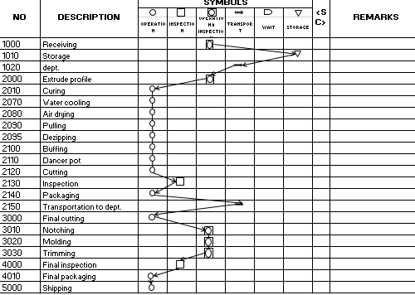
PFD example:
Determine Product or Process Functions
Notes:
Helps in developing equipment specifications.
How will the process control non-conforming material?
How and when will inspections be performed, what is required?
How and when will parts be re-introduced into the process?

Slide 38
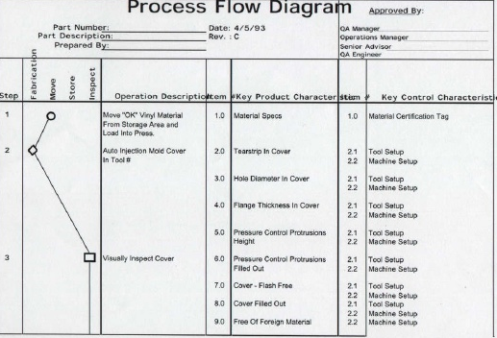
PFD example:
Determine Product or Process Functions
Notes:
Helps in developing equipment specifications.
How will the process control non-conforming material?
How and when will inspections be performed, what is required?
How and when will parts be re-introduced into the process?

Slide 39
7- The worksheet, form and documentation

Slide 40
PFMEA Form and Documentation
Potential Failure Modes – From the PFD (process flow diagram) list all credible failure modes or ways the process/test can fail before addressing failure effects and failure causes
  “What can possibly go wrong with this process/test?”
  “How can the part (component, assembly, or product) fail to meet the engineering criteria or specification?”
In each instance, the assumption is made that the failure could occur, but will not necessarily occur.
Each failure mode should be credible
Do not list acts of God or freak accidents
Examples of failure modes include:
  Bent, Cracked, Contaminated, Loosened, Leakage, Damaged, Deformed, Gouged, Misaligned, Corroded, Broken Tooling, Wrong Tooling, Wrinkled, Scratched, Humidity, Handling Damage, etc

Slide 41
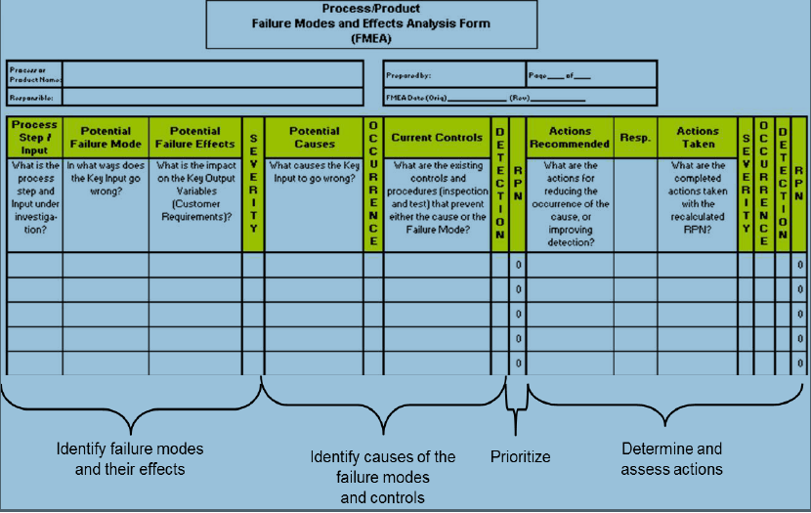
The PFMEA Worksheet

Slide 42
The PFMEA Worksheet
1
2
3
4
5
6
7
Determine
Product or
Process
Functions
Determine
“Effects” of
The Failure
Mode
Severity
Rating
Determine
“Controls”
Detection
Rating
Develop
and
Drive
Action Plan
Determine
“Causes” of
The Failure
Mode
Occurrence
Rating
Determine
Failure
Modes
of Function
Calculate
&
Assess
Risk
If an PFMEA was created during the Design Phase of the Program, USE IT!
Create an Action Plan for YOUR ROOT CAUSE
and Re-Evaluate the RPN Accordingly

Slide 43
Contents of a FMEA
Process Function
  Record the process number and its name
  Give a brief description of the steps within each process
Notes:
Read/paraphrase and discuss as needed

Slide 44
Contents of a FMEA
Process Function
  Potential Failure Mode
  Identify the potential product
  & Process-related failure modes
Notes:
Read/paraphrase and discuss as needed

Slide 45
Contents of a FMEA
Potential Effect(s) of Failure
Assess the effect of the particular failure on the customer(s)
This may include an internal customer through to the ultimate end user
Notes:
Read/paraphrase and discuss as needed

Slide 46
Contents of a FMEA
Severity (S)
Rank the impact of the failure mode on the customer
Rating from 1 to 10 with 10 being the most severe
Notes:
Read/paraphrase and discuss as needed

Slide 47
Severity of Effect DFMEA

Slide 48
The severity ranking can only be reduced by a design change to the vehicle system or product design
Data should be used to rank severity.
Master PFMEA shall be an input from customer
Notes:
Story of an uncrimped blah blah that was originally thought to be just a rattle would be the result. Actual testing on the inflator resulted in fragmentation.

Slide 49
Contents of a FMEA
Severity (S)
Rank the impact of the failure mode on the customer
Rating from 1 to 10 with 10 being the most severe
Require special assessment
Capability
Poka Yokes
100% Inspection
Notes:
Read/paraphrase and discuss as needed

Slide 50
Contents of a FMEA
Potential Cause
of Failure
  List any possible causes for the failure mode (how the failure could occur)
Notes:
Read/paraphrase and discuss as needed

Slide 51
Contents of a FMEA
Occurrence (O)
A numerical rating of the likelihood that a specific cause of failure will occur
Rating from 1 to 10 with 10 being the most frequent occurrence
Notes:
Read/paraphrase and discuss as needed

Slide 53
Contents of a FMEA
Current Process Controls Prevention: Controls that prevent the cause of failure from occurring
Detection: Controls that detect the cause of a failure which leads to corrective actions
Notes:
Read/paraphrase and discuss as needed

Slide 54
Contents of a FMEA
Detection (D)
A numerical rating of the probability that a set of controls will detect a specific cause of failure
Rating from 1 to 10 with 10 being the least likely to detect
Notes:
Read/paraphrase and discuss as needed

Slide 56
Contents of a FMEA
Risk Priority Number (RPN)
The numerical product of the Severity (S), Occurrence (O) and Detection (D) ratings:
S x O x D = RPN
Notes:
Read/paraphrase and discuss as needed

Slide 57
Contents of a FMEA
Recommended Actions
List all actions required to reduce the overall RPN score, mandatory actions required if RPN score exceeds allowable limit (priority rules)
Notes:
Read/paraphrase and discuss as needed

Slide 58
Contents of a FMEA
Responsibility & Target Completion Date
Identify who is responsible for completing the recommended actions by the specified target dates
Notes:
Read/paraphrase and discuss as needed

Slide 59
Contents of a FMEA
Action Results
Identifies what was actually done and the impact on the categories described earlier (severity, occurrence, detection, risk priority number, and classification)
What are the failure modes?
Paper not stapled
Staple position
Improper crimp
Finger stapled to paper
Notes:
Read/paraphrase and discuss as needed

Slide 60
What is the FMEA Goal?
Reduce the risk of designing and manufacturing bad products by anticipating and preventing potential failure modes and their causes
Notes:
Read/paraphrase and discuss as needed

Slide 61
FMEA Risk reductio
Priority steps for risk reduction:
High severity's (9, 10)
High RPN´s (> 100)
Also consider this example:
Severity = 5, Occurrence = 8, Detection = 2 ⇒ RPN = 80
There is a high possibility that the failure will be discovered, nevertheless the failure occurs in 1 of 8 parts ⇒ bad product/process design ⇒ high costs. Therefore, action must be taken to improve design/process.
Some organizations make their prioritizations according severity X occurrence.
Continuous improvement efforts aimed at reducing risk will
eliminate waste and reduce costs!

Slide 62
CONTROL PLAN

Slide 63
Purpose of a Control Plan?
It is important to note that there is a direct relationship from the Process FMEA to a Process Control Plan.
FMEA is considered a rigorous preventive method for identifying, and assessing potential failures of a system. It is a prevention tool, it defines, identifies, prioritizes, eliminates potential failures or the failures known in the earliest stage possible. Its results are inputs in the control plan.
Notes:
Read/paraphrase and discuss as needed

Slide 64
Purpose of a Control Plan?
What is a Control Plan?
A Control Plan is a method for documenting the functional elements of quality control that are to be implemented in order to assure that quality standards are met for a particular product or service. The intent of the control plan is to formalize and document the system of control that will be utilized to prevent the potential failures found in the PFMEA.
Notes:
Read/paraphrase and discuss as needed

Slide 65
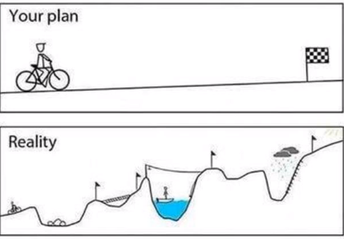
Purpose of a Control Plan?
A process
The variation showed in the reality picture need to be controlled
Notes:
Read/paraphrase and discuss as needed

Slide 66
Purpose of a Control Plan?
The intent of a Control Plan is to create a structured approach for control of process and product elements while focusing the organization on characteristics important to the customer.
An important part of a Control Plan is a Reaction Plan that clearly specifies what action to take in case an out-of-control condition occurs.
Notes:
Read/paraphrase and discuss as needed

Slide 67
Purpose of a Control Plan?
1- To Control the risks identified in the P-FMEA (High RPNs)
2- A structured approach to control process and product characteristics
3- Focusses on Customer Requirements
4- Assure reaction plans are in place in case of out-of-control conditions
5- Provide a central document for communication of control methods
6- A Control Plan contains following key information:
Identification of the control factors
The specifications and tolerances
The measurement system Sample size and frequency The control method
The reaction plan
Control Plans are living documents, just like FMEA’s
Notes:
Read/paraphrase and discuss as needed

Slide 68
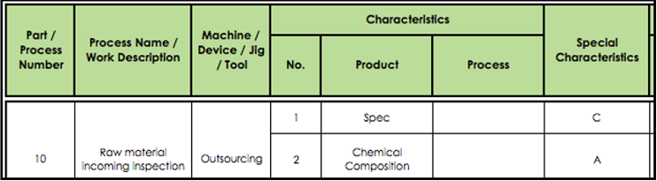
Example of Control Plan
Here are typical code letters for special characteristics:
A = Critical To Quality, a characteristic judged to be important to the fit and function of a component or assembly as well as customer satisfaction Critical to Quality (CTQ), need to have very specific actions taken
B = Functional dimensions and therefore tolerances need to be monitored
C = Need monitoring but calls for fewer resources
Or follow the special characteristics symbols given by your customer
Notes:
Read/paraphrase and discuss as needed

Slide 69
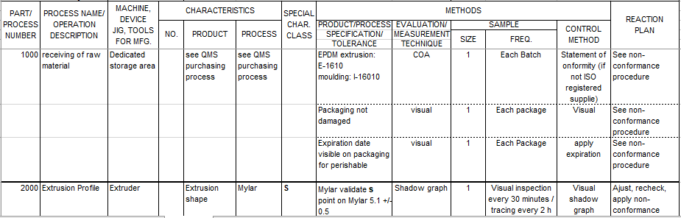
Example of Control Plan
Notes:
Read/paraphrase and discuss as needed

Slide 70
Why adding special characteristics to a Control Plan?
Why indicate whether a process step is CTQ?
Special characteristics added in a specific step of a process cotrol plan shows a characteristic that is critical.
Obviously anything that is Critical To Quality needs to be controlled more tightly.
How to know what issues to look out for?
We need that information when planning for controls. You need to follow the process steps and think "what controls are needed here?". A process FMEA is the tool that will help you decide where the controls need to be added to the process.
Why also include the products from suppliers?
Garbage in, garbage out. You absolutely need to check the quality of incoming material, in addition to your in-house processes.
Notes:
Read/paraphrase and discuss as needed

Slide 71
When is a Control Plan required?
In general, a PPAP is required anytime when a new part or a change to an existing part/process is being planned. It is the discretion of the customer to determine when and if a PPAP submission is required.
A Supplier should have all the necessary documentation ready for submission to the customer upon PPAP request
Notes:
Read/paraphrase and discuss as needed

Slide 72
Conclusion
A control plan lists all product and process inspection points required to deliver a defect-free outcome, and is essential for maintaining process control over the long run. While the control plan example on this page is manufacturing related, the same concept can be adapted to any number of physical or transactional work processes.
Notes:
Read/paraphrase and discuss as needed

