Slide 1
DPAR Training Material
Nordin Mimouni – Supplier Quality Manager
Rev. 4 – Nov. 25th 2019

Slide 2
Training Outline
DPAR Purpose and objectives
DPAR Participants
Understanding the DPAR Template
Supplier Expectations

Slide 3
DPAR Purpose and objectives
DPAR stands for Design, Process and Assembly Review
Purpose: commitment from Supplier AND Camso cross functional teams on a product/(process/service) feasibility
Target: Zero Defects and Time to Market
We ensure we clarified all requirements in terms of manufacturability, quality, packaging definition and timing and we ensure Supplier understands them
  Create/Complete actions to agree on a drawing and measurement method for tool kick off
  Target for supplier to provide parts 100% to drawing at PPAP submission on-time
DPAR required for each new design developed by Camso / Engineering Change Request / Supplier Change Request
Notes:
1- DPAR = Design Process & Assembly review
2- Purpose for DPAR process is to get a commitment from Supplier and Camso cross functional teams regarding feasibility of a product/(process/service): we mostly use it for a product development but we could extend it (ex.: moulds)
This includes feasibility in design, manufacturability, quality, packaging definition and timing in order to minimize any risk and cost avoidance upfront.
3- Achieving Zero Defects and Time to Market
Zero defect: do good, the 1st time
Time to market: on time
3- Any change ➔ question the impact, adjust what you need to review in the DPAR

Slide 4
DPAR Participants
Participants (mandatory)
Support (if necessary)
Camso – Procurement Project Leader
Camso – SPQD Function
Camso – Facility QA
Camso – Product Engineer
Supplier - Representative(s) (covering functions: Engineering, Tooling, Quality, Account Management, Sales)
Camso – Project Manager
Camso – Tool Engineer
Camso – Logistics
Camso – Industrial Engineer
Camso – Raw Material Expert
Supplier – Tool Maker
Supplier – Logistics
Notes:
PPL = Bandleader
SPQD = APQP owner
Facility QA = voice of the customer
PE = voice of the customer and design owner
Adjust your Supplier team accordingly
We need to feel a Team effort!

Slide 5
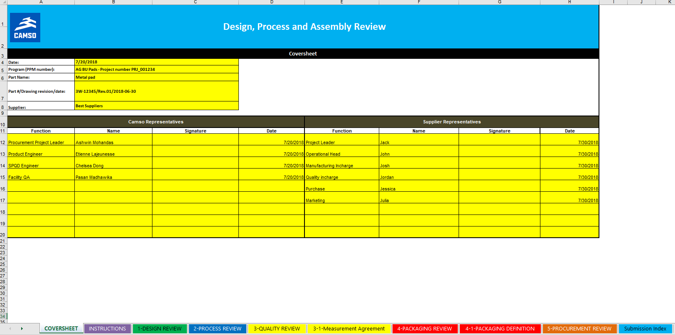
Understanding the DPAR Template
Sections
Sum up of DPAR steps
1
Sections to be reviewed, fulfilled and submitted by Supplier to Camso prior to DPAR meeting
Camso Team shall also review and fulfill those sections prior to DPAR meeting
2

Slide 6
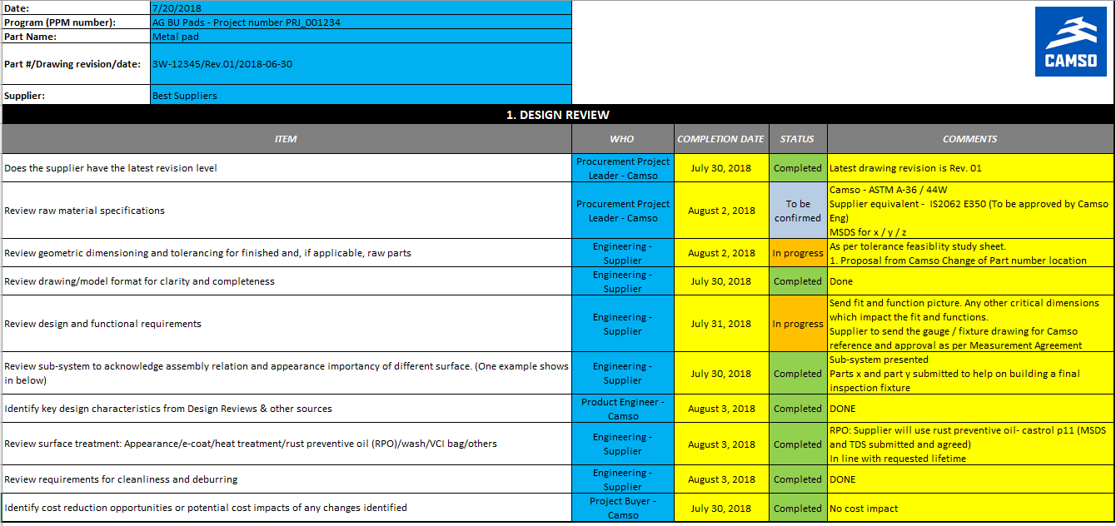
Understanding the DPAR Template
Tab 1: Design Review
  Camso Input: Information fulfilled by Camso Procurement Project Leader before meeting
  Camso Input: fulfilled by Procurement Project Leader, reviewed and agreed during DPAR meeting
1
  Camso/Supplier Input: fulfilled by Procurement Project Leader, these fields shall list all data shared during DPAR (drawings, specifications, CAD data, systems screenshots…)
  Camso/Supplier Input: actions to be prepared by assigned responsible
2
3
4
Yellow fields: to be filled in
Blue fields: no need to fill in
Notes:
Design review. We need to add a formal review of design verifications for Supplier.
For instance, for castings, we shall expect supplier to show us mold fill analysis and solidification to identify shrinkage risk, porosity risk…
Manufacturability: supplier shall confirm our design is fit for manufacturability (GD&T but also simple machining, limit number of tool change, holes sizes to evacuate sands sufficient…)

Slide 7
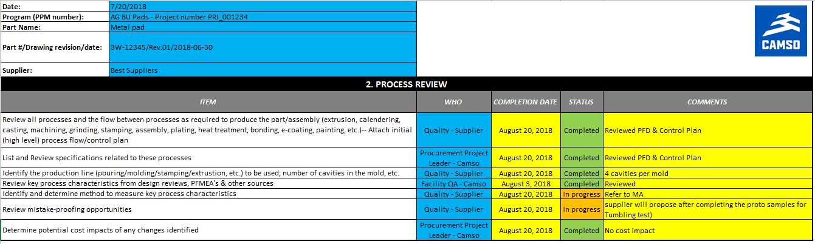
Understanding the DPAR Template
Tab 2: Process Review
  Camso Input: fulfilled by Procurement Project Leader, reviewed and agreed during DPAR meeting
  Camso/Supplier Input: fulfilled by Procurement Project Leader, these fields shall list all data shared during DPAR (drawings, specifications, CAD data, systems screenshots…)
  Camso/Supplier Input: actions to be prepared by assigned responsible
1
2
3

Slide 8
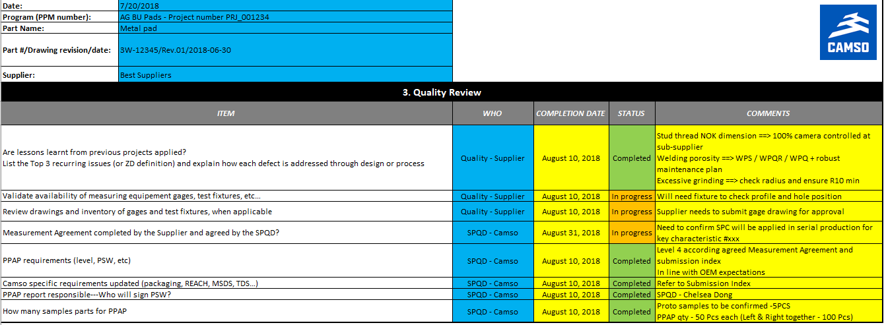
Understanding the DPAR Template
Tab 3: Quality Review
  Camso Input: fulfilled by Procurement Project Leader, reviewed and agreed during DPAR meeting
  Camso/Supplier Input: fulfilled by Procurement Project Leader, these fields shall list all data shared during DPAR (drawings, specifications…)
  Camso/Supplier Input: actions to be prepared by assigned responsible
1
2
3
NEW
Notes:
NEW: Lessons Learnt from previous projects!

Slide 9
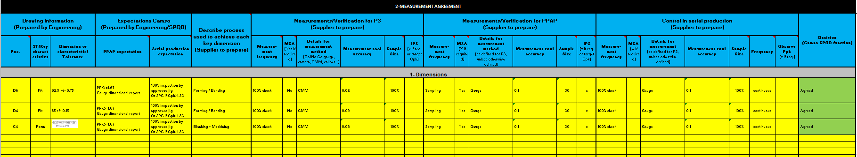
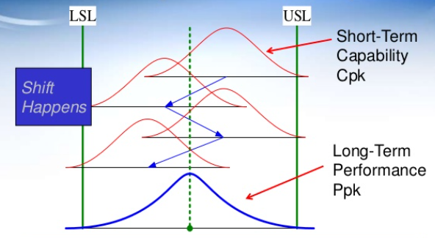
Understanding the DPAR Template
Tab 3-1: Measurement Agreement - example
  Camso Input: Information fulfilled by Camso Engineering and submitted to Supplier before the DPAR meeting
  Camso Input: Information fulfilled by Camso Engineering + SPQD and submitted to Supplier before the DPAR meeting
  Supplier Input: Information fulfilled by Supplier and submitted to Camso before the DPAR meeting
  Supplier Input: Information fulfilled by Supplier and submitted to Camso before the DPAR meeting
  The 3 sections have to be prepared (P3, PPAP, Production)
  Camso Input: Information fulfilled , reviewed and agreed during DPAR by SPQD: Approved/Not Approved
1
2
3
4
5
Measurement frequency:
Poka Yoke: mistake-proofing system
SPC: Statistical Process Control
MSA: Measurement System Analysis
Cpk: Process Capability Index. Adjustment of C_{p} for the effect of non-centered distribution
Ppk: Process Performance Index. Adjustment of P_{p} for the effect of non-centered distribution
IPS: Initial Process Studies
PPAP: Production Part Approval Process
Notes:
Notes: the Measurement agreement is an input to Supplier Control Plan and to Camso incoming inspection plan
This is supplier’s responsibility to ensure this agreement is fully applied in related control plans.
Furthermore, the SPQD has the responsibility to confirm delverables have been submitted for the P3 phase in line with the MA, same for PPAP (and related documents like PFD – CP – FMEA)
Impact of no measurement agreement: CoPQ (misalignment on methods, late identification of process gaps vs needs, PSI costs…)

Slide 10
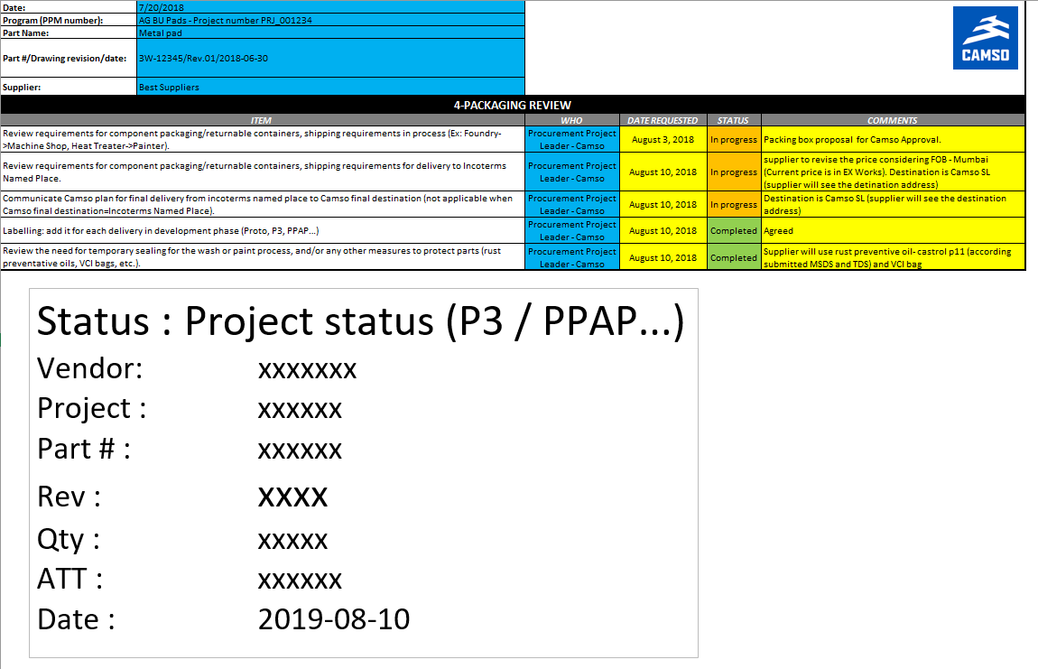
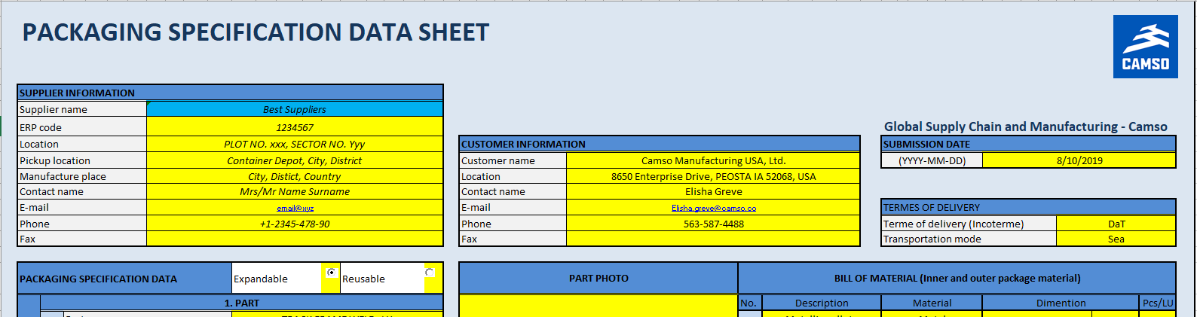
Understanding the DPAR Template
Tab 4: Packaging Review
  Camso/Supplier Input: fulfilled by Procurement Project Leader, these fields shall list all data shared during DPAR (drawings, specifications…)
  Camso Input: fulfilled by Procurement Project Leader, reviewed and agreed during DPAR meeting
  Camso/Supplier Input: actions to be prepared by assigned responsible
1
2
3
NEW

Slide 11
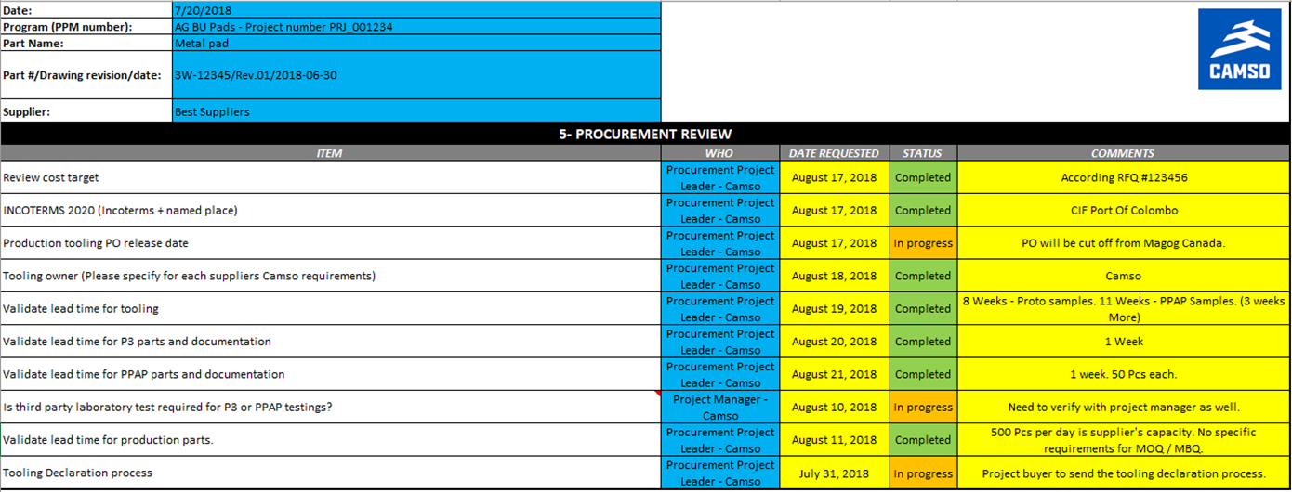
Understanding the DPAR Template
Tab 5: Procurement Review
  Camso Input: fulfilled by Procurement Project Leader, reviewed and agreed during DPAR meeting
  Camso/Supplier Input: fulfilled by Procurement Project Leader, these fields shall list all data shared during DPAR (drawings, specifications…)
  Camso/Supplier Input: actions to be prepared by assigned responsible
1
2
3

Slide 12
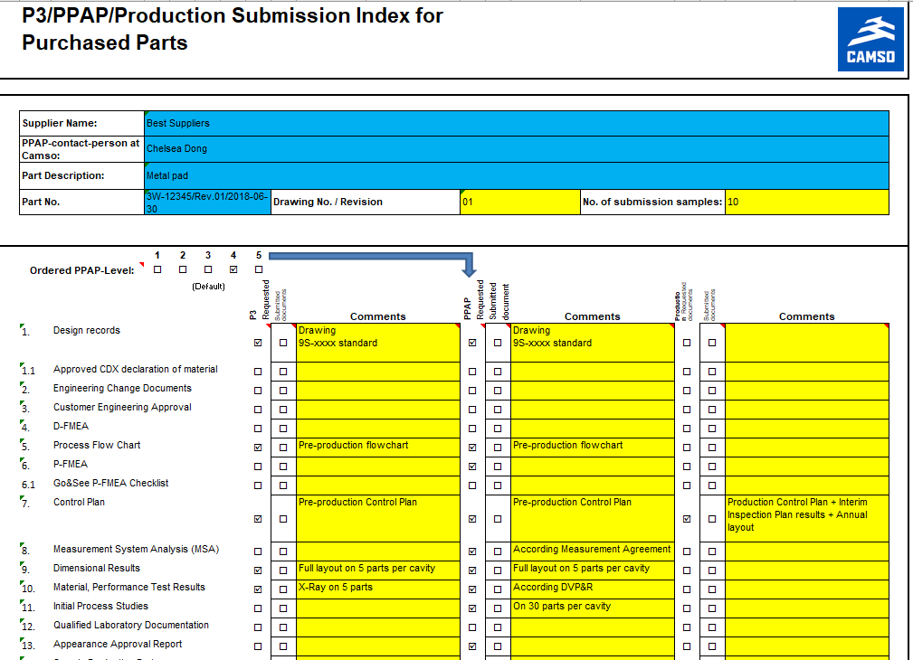
Understanding the DPAR Template
Tab: Submission Index
1
Camso Input: fulfilled by SPQD, reviewed and agreed during DPAR meeting
1- drawing rev and samples
2- Standard PPAP level is 4
3- New: SPQD can request a P3 “package”
4- New: SPQD can request a Production “package”
2
3
2
4

Slide 13
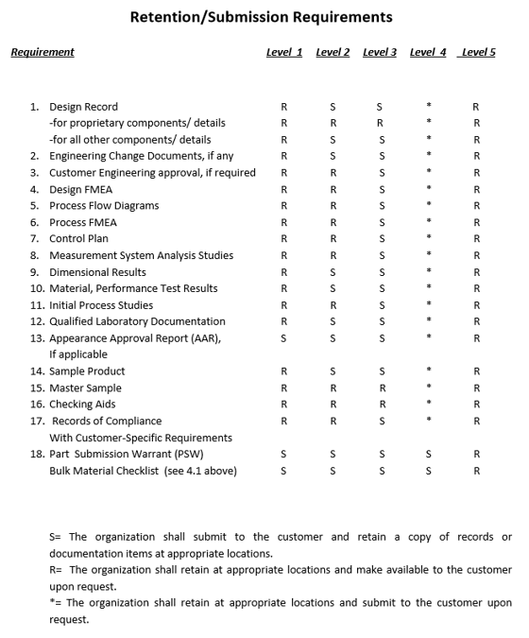
Understanding the DPAR Template
Tab: PPAP Submission Index
  Camso Input: this is an aid to remind the Team of PPAP manual chapters
2
1
  Camso Input: this is an aid to remind the Supplier of
  Chapters to be retained
  Chapters to be submitted
  For each PPAP level
  NOTA: whatever PPAP level we ask for, ALL chapters are required. The only difference is the submitted chapters

Slide 14
Supplier Expectations
Review each “note” and “dimensions” from drawing for concerns
Check measurability for each characteristic
Proactively suggest solutions for each concern identified
Suggest improvements for more robust production (quality and efficiency)
Promote open and honest communication with Camso
  Address issues/concerns as soon as possible
  Response in a timely manner to achieve project milestones
Supplier responsible to meet agreed timing
Supplier representatives shall sign off each DPAR tab as a confirmation of feasibility

Slide 15
Thanks for your participation

Slide 16

Questions?

