Slide 1
CoPQ Management
Training Material
Nordin Mimouni – Supplier Quality Manager
Rev. 01 - June 9th 2017

Slide 2
Training Outline
Definitions
CoPQ – What’s inside???
CoPQ Management - Purpose and objectives
CoPQ scope and criticity to the business
CoPQ Workshop Participants
Understanding the CoPQ Management Process

Slide 3
Definitions - CoPQ
CoPQ stands for Cost of Poor Quality
Direct impact on OUR bottom line
Sum of controllable and non controllable costs linked to a service or product to ensure its compliance or to correct a non compliance
Sum on non-added value activities/waste: MUDA
Notes:
Question: What is the difference between controllable and non controllable costs??

Slide 4
Definitions - MUDA
MUDA is the Japanese word for waste
All activities that does not add value to what you deliver
All activities that Customer don’t want to pay for
Eight types of MUDA
Notes:
Insist on CAMSO loss of reputation

Slide 5
Definitions – JIDOKA
JIDO = Automation
KA = Smart, Intelligent
A machine with a human touch that can tell normal from abnormal
Consists of two parts:
  Stop and Notify: can be ANDON
    When processing is finished
    in case of abnormality
  Seperate man from machines
Notes:
Insist on CAMSO loss of reputation

Slide 6
CoPQ - What is inside?
?
Notes:
Give post its to participants
2 min to list out what’s in it
Make a 1st classification: controllable (prevention/appraisal) / non controllable (internal/external failures)

Slide 7
This is our initial picture - Shawinigan
Controllable
100% inspection
Additional onsite inspection
Audits
Design validation
DFMEA
PFMEA
ECN product?
Non Controllable
Scraps in production
Inspections in case of NC
Warranty costs
Rework
« Bulletin de service » in case of NC
Design issues
NC packaging
ECN product
Premium freight
Late deliveries supplier
Late deliveries customer
Line stoppage
Price increase Supplier
Notes:
Give post its to participants
2 min to list out what’s in it
Make a 1st classification: controllable (prevention/appraisal) / non controllable (internal/external failures)

Slide 8
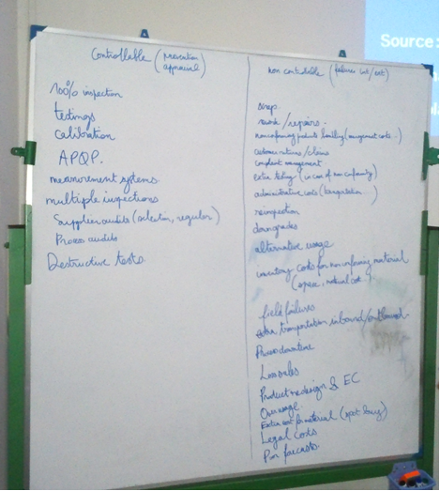
This is our initial picture - LOADSTAR
Notes:
Give post its to participants
2 min to list out what’s in it
Make a 1st classification: controllable (prevention/appraisal) / non controllable (internal/external failures)

Slide 9
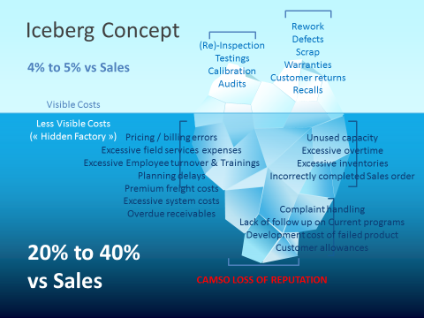
CoPQ scope and criticity to the business
Notes:
Ask participants

Slide 10
CoPQ Management – Purpose and objectives
Cross-functional Team approach to
  Collect and classify data
  Define scope (which part of the iceberg?)
  Define JIDOKA
  Define routine
  Measure effectiveness and efficiency
Continuous improvement contributing to Zero Defect Approach
Not limited to external costs
Scope is very wide! It can go from an internal process issue to CAMSO loss of reputation
Target: Identify and tackle abnormalities
Notes:
Insist on CAMSO loss of reputation
Recurrence was changed to abnormalities: recurrence is an example of abnormality

Slide 11
CoPQ scope and criticity to the business
CAMSO loss of reputation can cost up to…?
Notes:
Ask participants

Slide 12
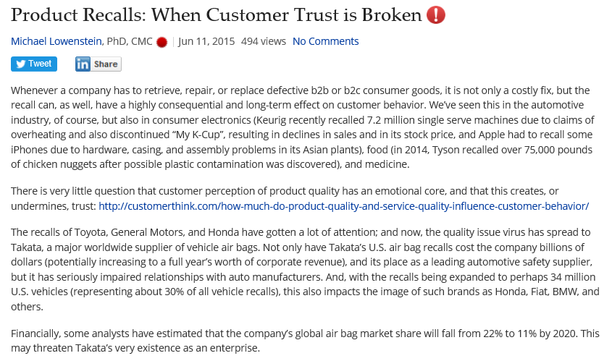
CoPQ scope and criticity to the business
Status on
Jun. 25th, 2017

Slide 13
CoPQ scope and criticity to the business
CAMSO loss of reputation can cost up to its existence
Notes:
Ask participants

Slide 14
COPQ Management stakeholders
Participants
Support (if necessary)
Operator
Procurement Project Leader
Facility Buyer
Facility QA
Production Leader
Logistics
Finance/Accountability
Supplier Quality
Lean specialist…

Slide 15
Understanding the COPQ Process
Collect and Classify data
Collect last 12 months data per type of cost, invoices, SAP data, investments, premium freights, calibration costs…
Use CoPQ table to classify them
Define CoPQ
Team decision on costs to be tackled
Team decision on costs to be collected for a next session
Go on Gemba to test each JIDOKA
Define abnormality
Efficiency: avoid recurrence
Define review Routine
Define JIDOKA
Define CoPQ v1.0
Prioritize simple to complex
Define KPI
Define each JIDOKA RASCI
Prioritize automatic to manual
Estimate total opportunities
Use existing routines (non conform areas, blocked stocks review…)
Define RASCI
Effectiveness: ability to recover
5 steps
Zero Defect Approach
Continuous Improvement
Notes:
Day I – Collect data and set up a 1st definition
Ideally a champion is designated to coordinate this activity.
Let’s start! A phase of preparation is necessary to start collecting data. Preferably, collect last 12 months to have already an overview of costs types and amounts.
Which data can we get? Invoices, SAP data, investments on controlling tools, ???
You only have partial data? Don’t worry! This phase helps to discover our costs and detect opportunities
Use COPQ table to start classifying them
Present COPQ table and create Teams per group of COPQ
Present results to the Group
Identify opportunities with the Group by consensus
Focus on simple JIDOKA: what can be measured automatically has to be prioritized to manual
Agree on 1st definition
Advice: make it as simple as possible. Can be frustrating but Team has to understand that target will be to manage those costs.
For partial collected costs, you can decide to complete collection as part of an action plan without including in current definition.
Take some distance, try to get the complete picture: where are we vs iceberg image?
You can already draw a 1st draft of estimated COPQ for the organization
You can use WALK tool to present to the organization
Day II – Define JIDOKA + KPI
Define Teams to work on standardizing JIDOKA
As explained, make it simple, as simple as possible, as “automated” as possible
Don’t create new JIDOKA definition when something already exists: ie non conformance JIDOKA form,
KPI: effectiveness (recovery %), efficiency (recurrence %)
Day III – Define Routine
Prioritize usage of existing routines
Integrate the tool
Define RASCI
When process is mature enough, use Deming wheel concept
In line with Zero Defect Approach: we need to keep a sensitive KPI

Slide 16
Conclusion
CoPQ management is a continuous improvement process to reduce MUDA
CoPQ management starts with JIDOKA
CoPQ shall target non recurrence of abnormalities
CoPQ management is sustainable when integrated to existing routines!
CoPQ provides a valuable overview of potential gains in our cost structure

Slide 17
Let’s start our journey!

Slide 18
Back up slides

Slide 19

Prevention Costs
Prevention costs are associated with design, implementation, maintenance, and planning prior to actual operation, in order to avoid defects from happening.
The emphasis is on the prevention of defects in order to reduce the probability of producing defective products. Prevention activities lead to reduction of appraisal costs and both type of failures ( internal and external ).The motto is “Prevention rather than appraisal” .

Slide 20
Activities associated with Prevention costs
Market research
Quality training programs.
Contract review
Design review
Field trials
Supplier evaluation
Process plan review
Process capability review
Design and manufacture of jigs and fixtures
Preventive checks & maintenance

Slide 21

Appraisal costs
Appraisal costs are spent to detect defects to assure conformance to quality standards
Appraisal cost activities sums up to the “cost of checking if things are correct”.
The appraisal costs are focused on the discovery of defects rather than prevention of defects

Slide 22
Activities associated with Appraisal costs
Prototype testing
Vendor surveillance
Incoming material inspection
Process inspection/control
Final inspection
Laboratory testing / measurement
Depreciation cost for measuring
Quality audits.

Slide 23
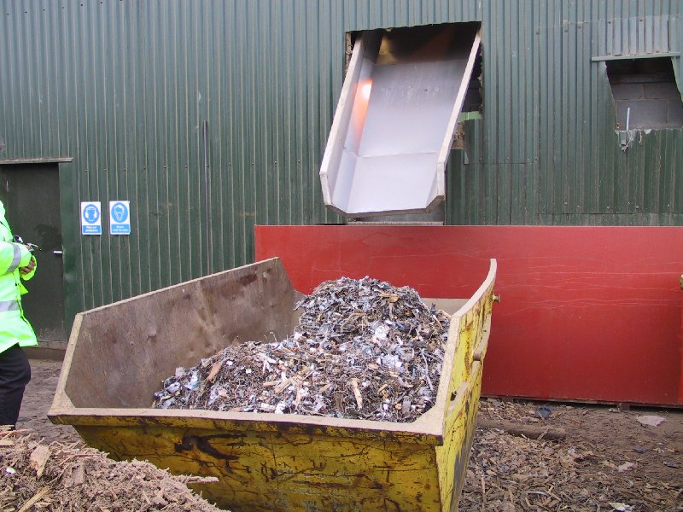
Internal failure costs
Internal failure costs occurs when results of work fail to reach designated quality standards and are detected before transfer to the customer takes place.

Slide 24
Examples
Internal failure costs
Design changes/ corrective action
Scrap due to design changes
Excess inventory
Rectification / reject disposition of purchased material
Rework/rejection in manufacturing
Downgrading of end product
Downtime of plant & machinery
Trouble-shooting & investigation of defects

Slide 25

External failure costs
External failure costs occur when the product or service from a process fails to reach designated quality standards and is not detected until after transfer to the customer.

Slide 26
Activities associated with External failure costs
Processing / investigation of customer complaint
Repair/replacement of sold goods
Warranty claims
Product liability & litigation costs
Interest charges on delayed payment due to quality problems
Loss of customer goodwill & sales.

Slide 27
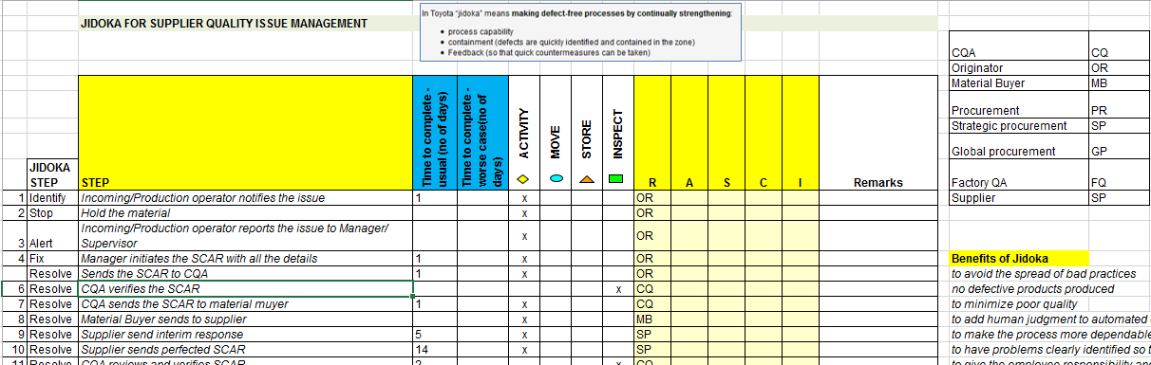
JIDOKA example
JIDOKA Name
Functions definition
JIDOKA
4 steps
RASCI
Step description

Slide 28
KPI example 1

Slide 29
KPI example 2

