Slide 1
QBR
Commodity Name
Supplier Name
QQ YYYY
Notes:
Precise your commodity name
Name of supplier
Quarter (fiscal year) – starting month to end month of the quarter in study

Slide 2







AGENDA
01
Attendees
02
Performance Review
03
Projects
Review
04
Innovation
05
Strategic Review
06
Supplier Compliance
07
SWOT Review
08
Actions Review

Slide 3
01
Attendees

Slide 4

ATTENDEES
Material
Planner
Material
Manager
Quality
Manager
Category Sourcing Manager
Procurement
Manager
xxxx
xxxx
xxxx
xxxx
xxxx
Project
Buyer
Supplier
Quality
Manager
xxxx
Notes:
Complete with the names of the attendees from Camso only.
Since you will do only one quaterly business review for all BU, it’s possible that you have multiple names under one job title.

Slide 5
02
Performance Review

Slide 6






PERFORMANCE REVIEW
KEY PERFOMANCE INDICATORS
BU NAME
(PLANT NAME)
0
Defects
99%
99%
1068
QUALITY CONFORMANCE 6M AVERAGE
Notes:
Include data coming from Nordin’s team into excel file « QBR Camso Input File ».
Copy-paste FYTD diagram from excel file « QBR Camso Input File»
** One plant KPI information per slide. If your supplier supplies parts to different plant and BU’s, duplicate slides 6 to 10.

Slide 7
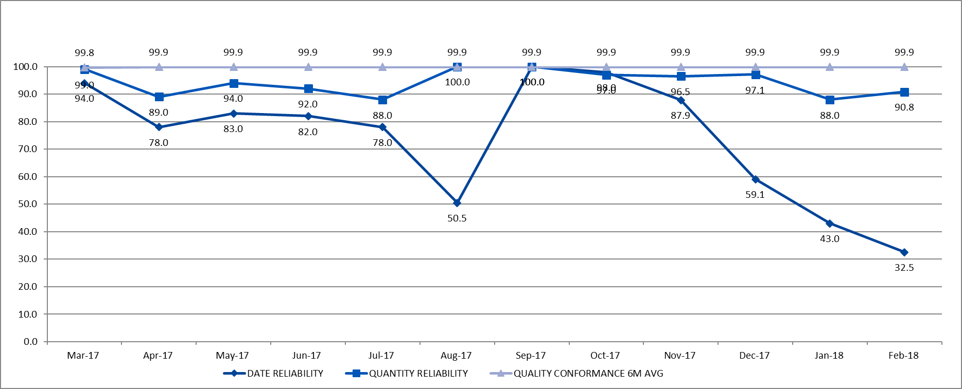
PERFORMANCE REVIEW
DATE-QUANTITY-QUALITY
BU NAME
(PLANT NAME)
Notes:
Copy-paste FYTD OTD diagram from slide « Key Performance indicator »
Copy-paste On time delivery graph from excel file « QBR Camso Input File ». Remove graph title since it’s already mentionned in the slide title.
Keep it as an hidden slide (back-up slide)

Slide 8



PERFORMANCE REVIEW
KPI ANALYSIS
BU NAME
ON TIME
DELIVERY
QUALITY CONFORMANCE
QUANTITY
RELIABILITY
XXXXXXXXXXXXX
XXXXXXXXXXXXXX
XXXXXXXXXXX
Notes:
Section for comments regarding the supplier’s quaterly performance.
Only but bullet point, you can verbaly say the details.
All meeting attendees should provide input for this slide.

Slide 9
03
Projects Review

Slide 10

PROJECTS REVIEW
PROJECTS OVERVIEW (ALL BU’S)
TO BE UPDATED
2017
2018
2019
2020
 |  | # of parts | Q1 | Q2 | Q3 | Q4 | Q1 | Q2 | Q3 | Q4 | Q1 | Q2 | Q3 | Q4 | Q1 | Q2 | Q3 | Q4
AG | PROJECT NAME 1 | 7 |  |  |  |  |  |  | $10K
CONS | PROJECT NAME 2 | 20 |  |  |  |  |  |  |  | $40K
LOI
SOP
LOI
SOP
Notes:
List the DEV projects (in progress or upcoming) for each BU.
Specifiy: the business unit, project name and the quantity of parts in development at the supplier.
Adjust the grey line according to the projects timeline and milestones.
Specify on the line the following phases: the Durability (or P3), LPB (or PPAP) and SOP
Specify at the SOP date : the estimated annuel units and the business value it represents (EAU * part price)
Could we integrate upcoming projects (future)?...

Slide 11

PROJECT REVIEW (Proc. Manager)
NEW PROJECTS OVERVIEW (HIGHLIGHTS/BOTTLENECKS)
TO BE UPDATED
TX750 & TX2000
CONS
Yeti
Blade
Runner
TTS
Europe
A-Tractive
(Claas)
RV 046
Highlights 1
Highlights 2
CONS
CONS
AG
PWS
Notes:
In the grey bubbles, include new projects NAMES that are coming ahead that your supplier could or will participate in.
In the text areas, insert a bullet point description of thoses projects.
** Only include projects that take place in the same plant. If you have many projects from many plants, duplicate the slide to have one slide per plant.

Slide 12
04
Innovation

Slide 13

INNOVATION (supplier)
VAVE / NEW TECHNOLOGIES / OTHER
AG
XXXX
DESCRIPTION
Notes:
Strategic buyer to send file « QBR SUPPLIER Input File » to supplier 1 week before scheduled QBR.
When supplier completes the requested information, copy-paste « VAVE » information.

Slide 14
INNOVATION
ENGINEERING CHANGES
PID
PID
Details of the engineering change …
Details of the engineering change …
DESCRIPTION
DESCRIPTION
To be prepared by Camso
Notes:
Material manager to list the engineering changes in progress or to come.

Slide 15
05
Strategic Review

Slide 16


STRATEGIC REVIEW
SPEND PLANT NAME
Notes:
Spend is for total business with supplier (all plants included).
Copy-paste FYTD SPEND diagram from excel file « QBR Camso Input File ».
Copy-paste Spend graph from excel file « QBR Camso Input File ». Remove graph title since it’s already mentionned in the slide title.
Update the volume rebate amount if applicable.
Do we want to show last 12 months trend? If positive, we could show.

Slide 17

STRATEGIC REVIEW
TO BE UPDATED
KEY CLIENTS PROPORTION
Notes:
Strategic buyer to send file « QBR SUPPLIER Input File » to supplier 1 week before scheduled QBR.
When supplier completes the requested information, copy-paste « Key Clients Proportion » graph to the slide and remove graph title since it’s already mentionned in the slide.

Slide 18
STRATEGIC REVIEW (Category sourcing + Proc Mgrs)
BUSINESS OVERVIEW
AG
PWS
CON
CON
Give an update of the AG BU …
Notes:
Include from general highlights regarding each BU.
For example:
an acquisition that can have an impact on the # of parts you will order from supplier
Increase in sells which can have an impact of capacity at the supplier
Performance of the BU in general
Restructuration in BU which can impact supplier’s main contact person
Etc.

Slide 19
06
Supplier Compliance

Slide 20
SUPPLIER COMPLIANCE
CONTRACT COMPLIANCE
Average
Good
50%
75%
Average
Good
Average
Good
Bad
Better
25%
100%
Bad
Better
Bad
Better
Payment terms
Safety Stock
SCAR
Response Time
RFQ
Timeliness
Notes:
Adjust the arrow for each measured criteria according to the supplier’s compliance level
Could we have a variance for Project Parts and Market Driver parts?

Slide 21
SUPPLIER COMPLIANCE
SCORECARDS
Notes:
Copy-past scorecard graph from excel file « QBR Camso Input File ».

Slide 22
07
SWOT Review

Slide 23
SWOT REVIEW (supplier)
PRODUCTION CAPACITY – LABOR FORCE (OVERALL)
Notes:
Strategic buyer to send file « QBR SUPPLIER Input File » to supplier 1 week before scheduled QBR.
When supplier completes the requested information, copy « labor force » graph to the slide and remove graph title since it’s already mentionned in the slide.

Slide 24
SWOT REVIEW (supplier)
PRODUCTION CAPACITY – EQUIPMENT & MACHINES (OVERALL)
Notes:
Strategic buyer to send file « QBR SUPPLIER Input File » to supplier 1 week before scheduled QBR.
When supplier completes the requested information, copy-paste « equipment and machines » graph to the slide and remove graph title since it’s already mentionned in the slide.

Slide 25
SWOT REVIEW (supplier)
RISK IDENTIFICATION
Notes:
Strategic buyer to send file « QBR SUPPLIER Input File » to supplier 1 week before scheduled QBR.
When supplier completes the requested information, copy-paste « Risk Identification » table to the slide.

Slide 26
SWOT REVIEW (Category Sourcing Mgr)
Strengths
Weaknesses
Opportunities
Threats
Notes:
Leader slide presentation Commodity Sourcing Manager or BU Procurement Manager

Slide 27
08
Actions Review

Slide 28

ACTIONS REVIEW
OPEN ITEMS
Priority | Subject | Activity description | Owner | Completion date | Revised Date | Status
Notes:
Update the list of open items from last QBR and add the new actions from your actual QBR.

Slide 29
Q&A
THANK YOU!

